Slide 1

KDE of Significant Severe Weather Hazardous
By Alex Flynt

Slide 2
Outline
Kernel Density Estimation of Significant Hail Events 1979–2018
Slides 3–6, 10-year sub-periods
Kernel Density Estimation of Significant Wind Events 1979–2018
65 Knots and Higher Events Slides 7–10, 10-year sub-periods
80 Knots and Higher Events Slides 11–14, 10-year sub-periods
Kernel Density Estimation of Significant Tornado Events 1989–2018
Number of Significant Tornado Events Slides 15–20, 5-year sub-periods
Number of Injuries Slides 21–26, 5-year sub-periods
Number of Deaths Slides 27–32, 5-year sub-periods

Slide 3
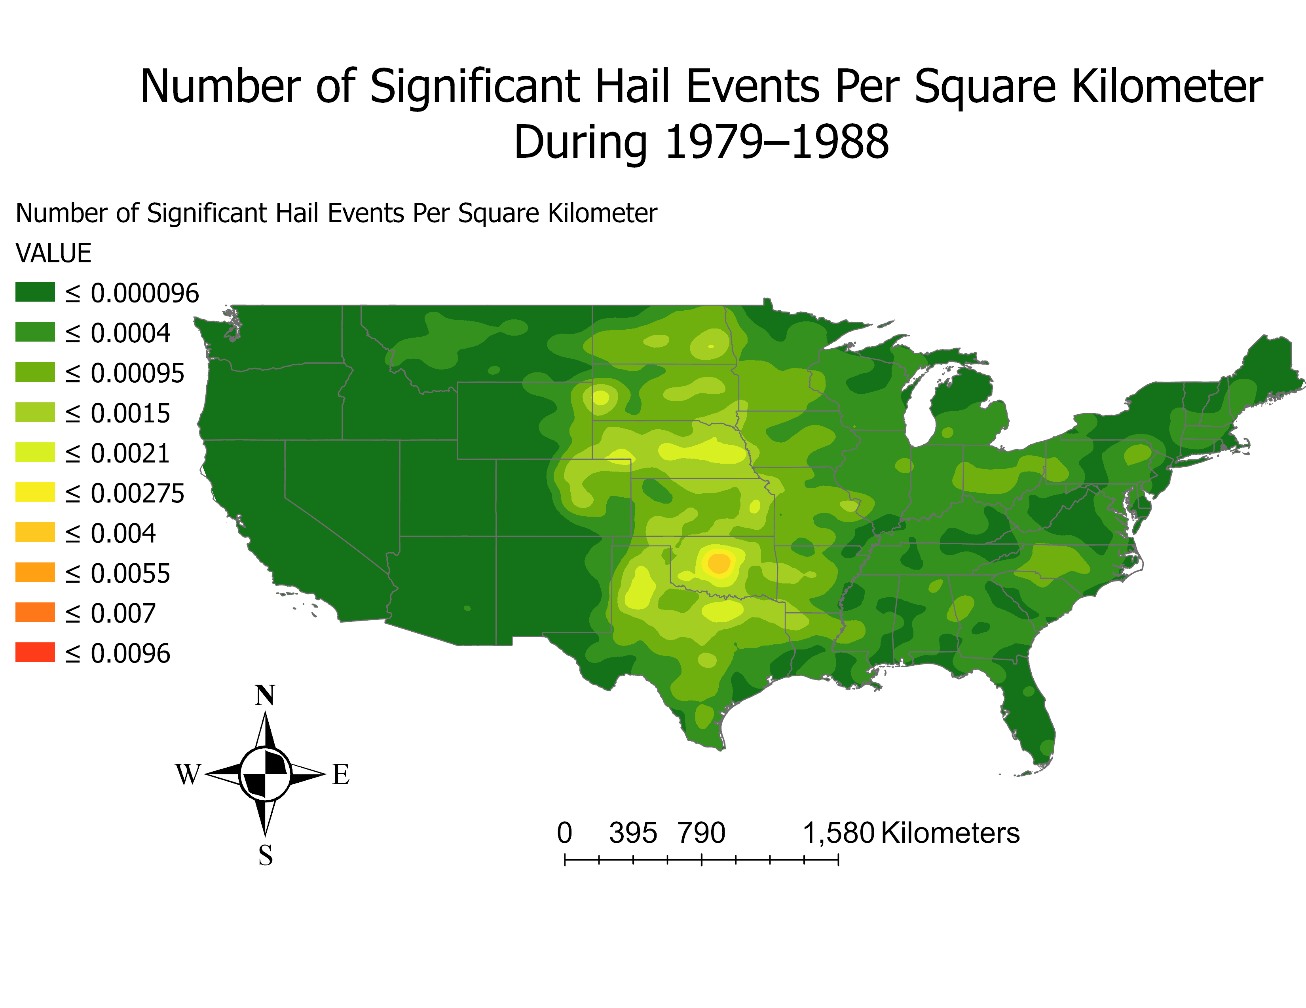

Slide 4
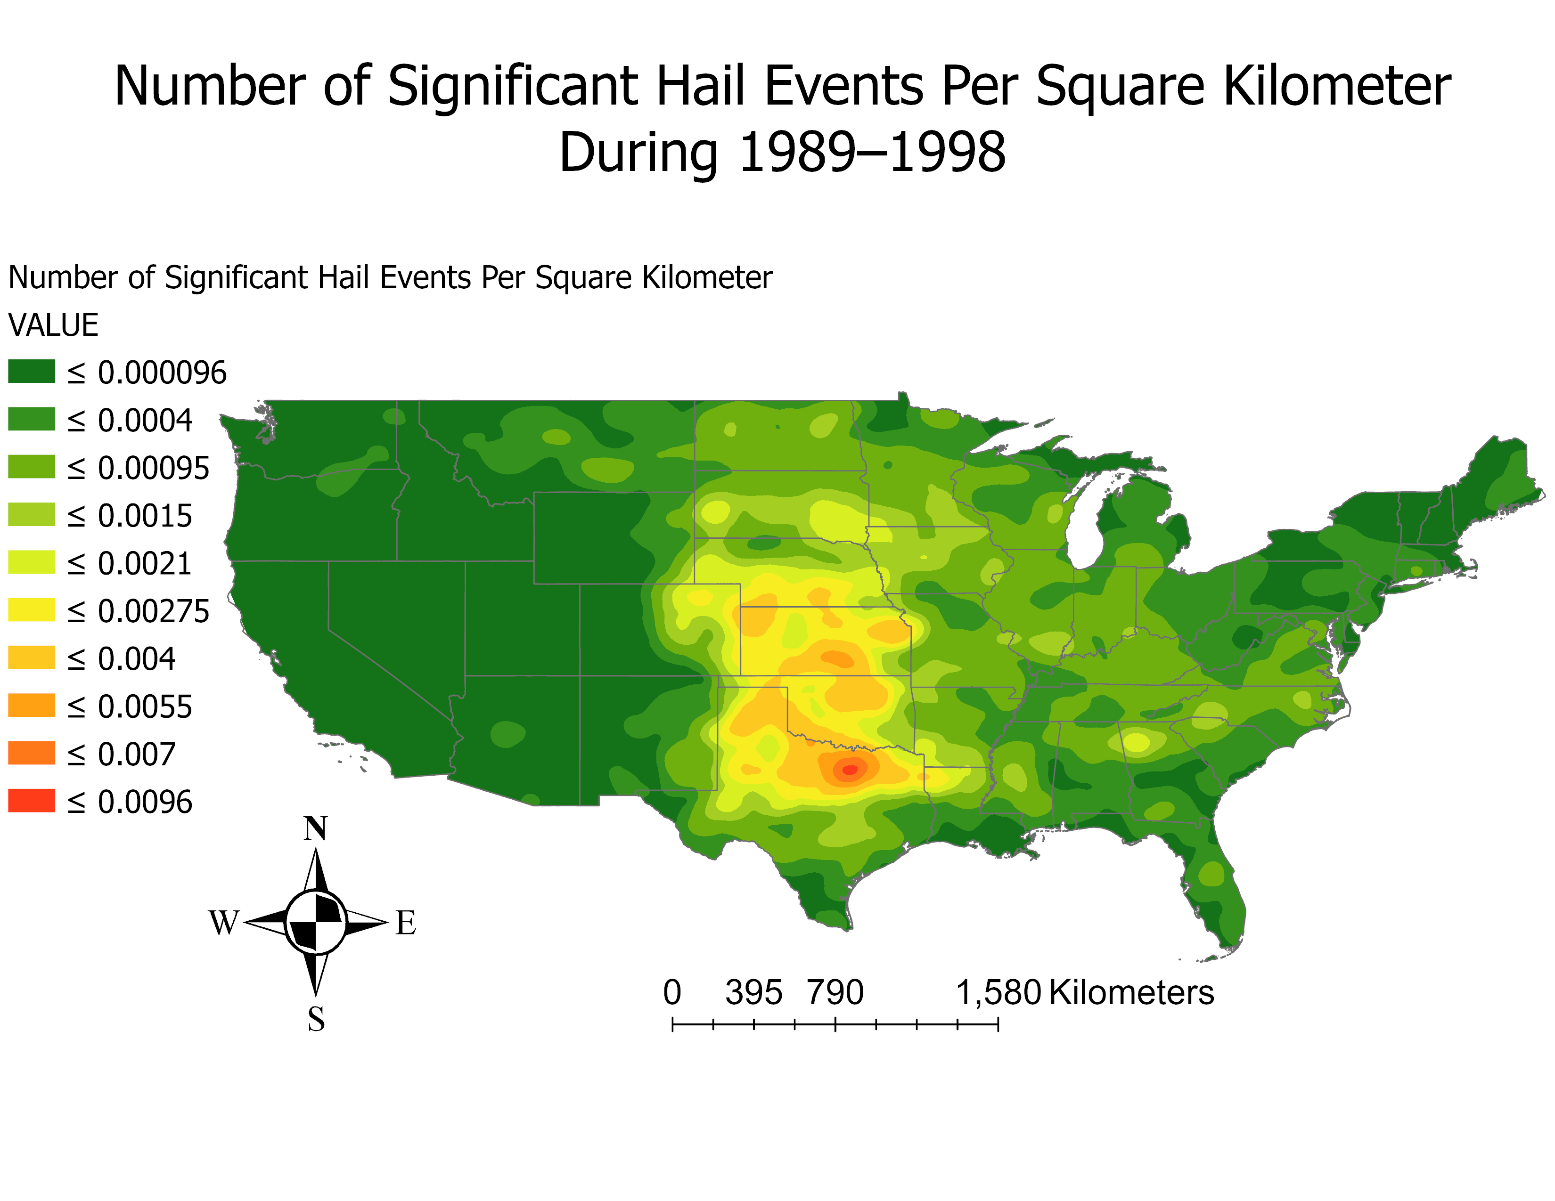

Slide 5
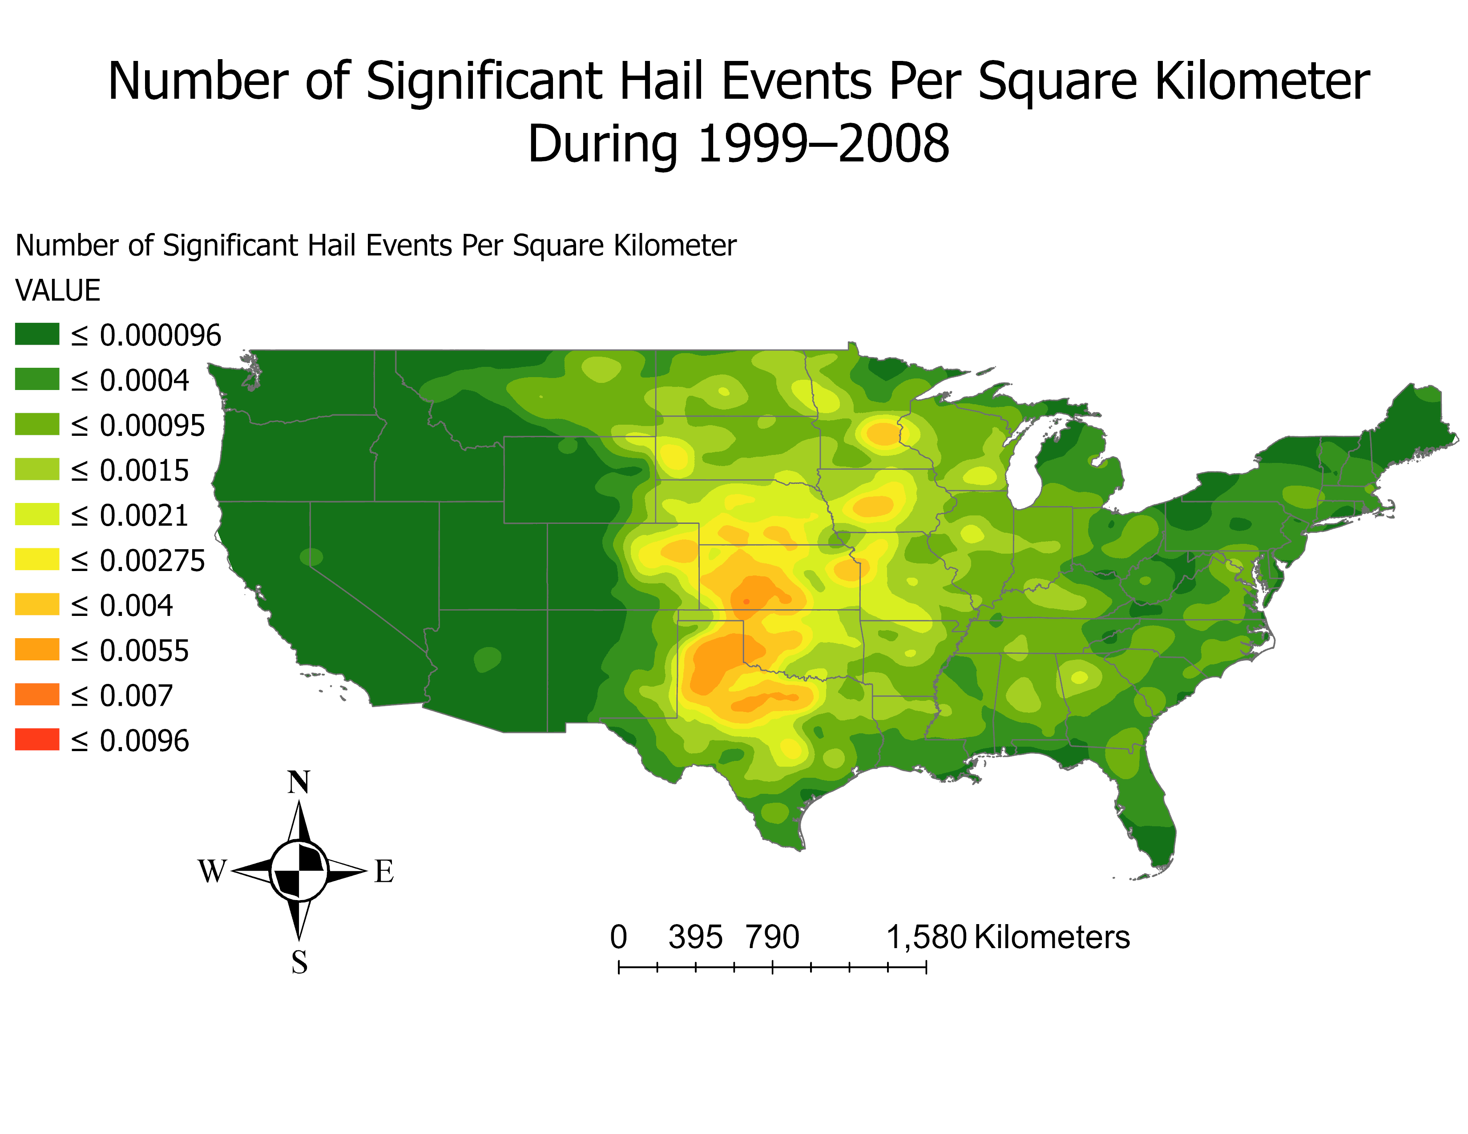

Slide 6
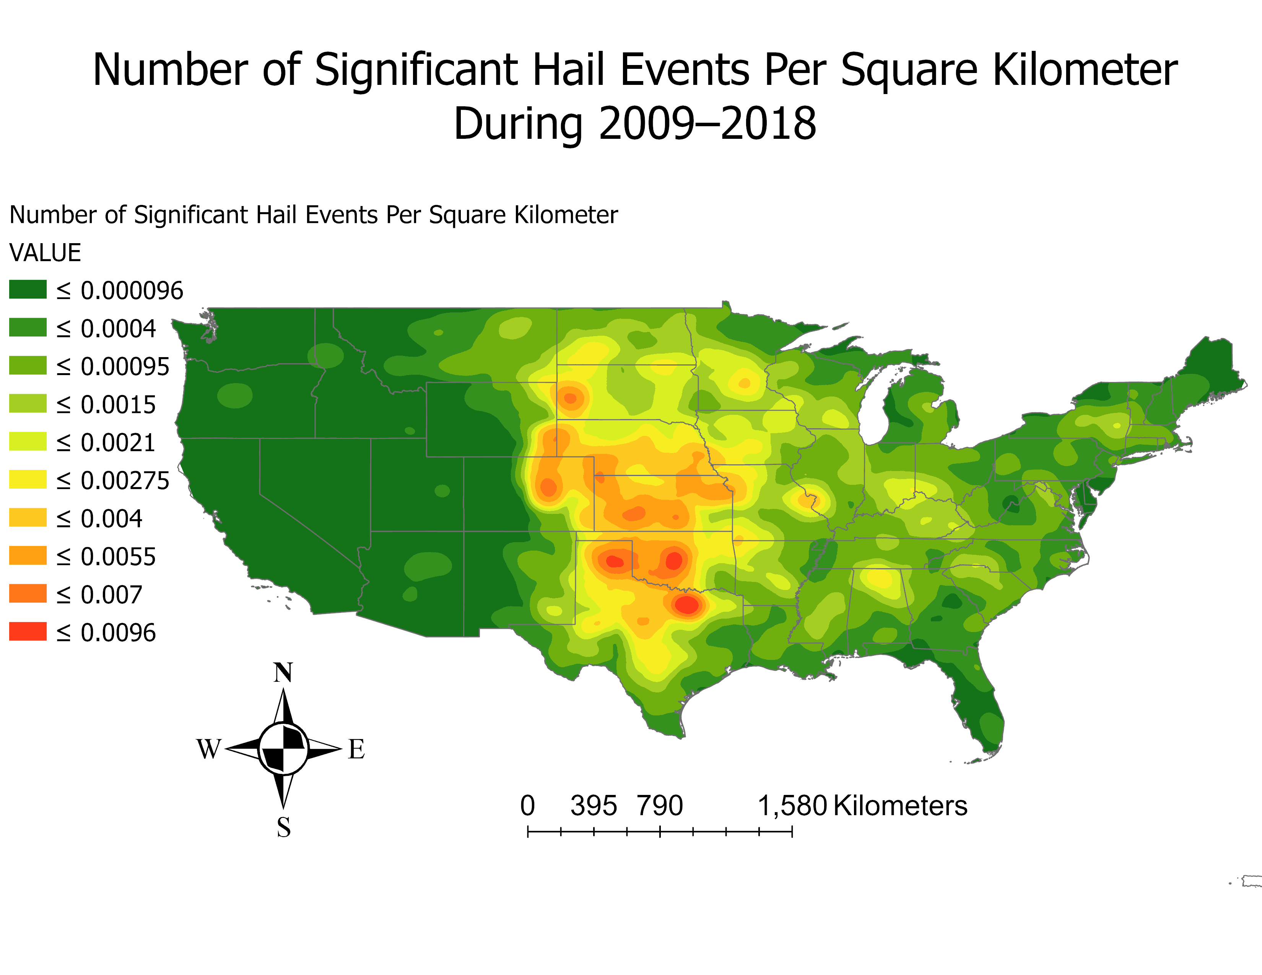

Slide 7
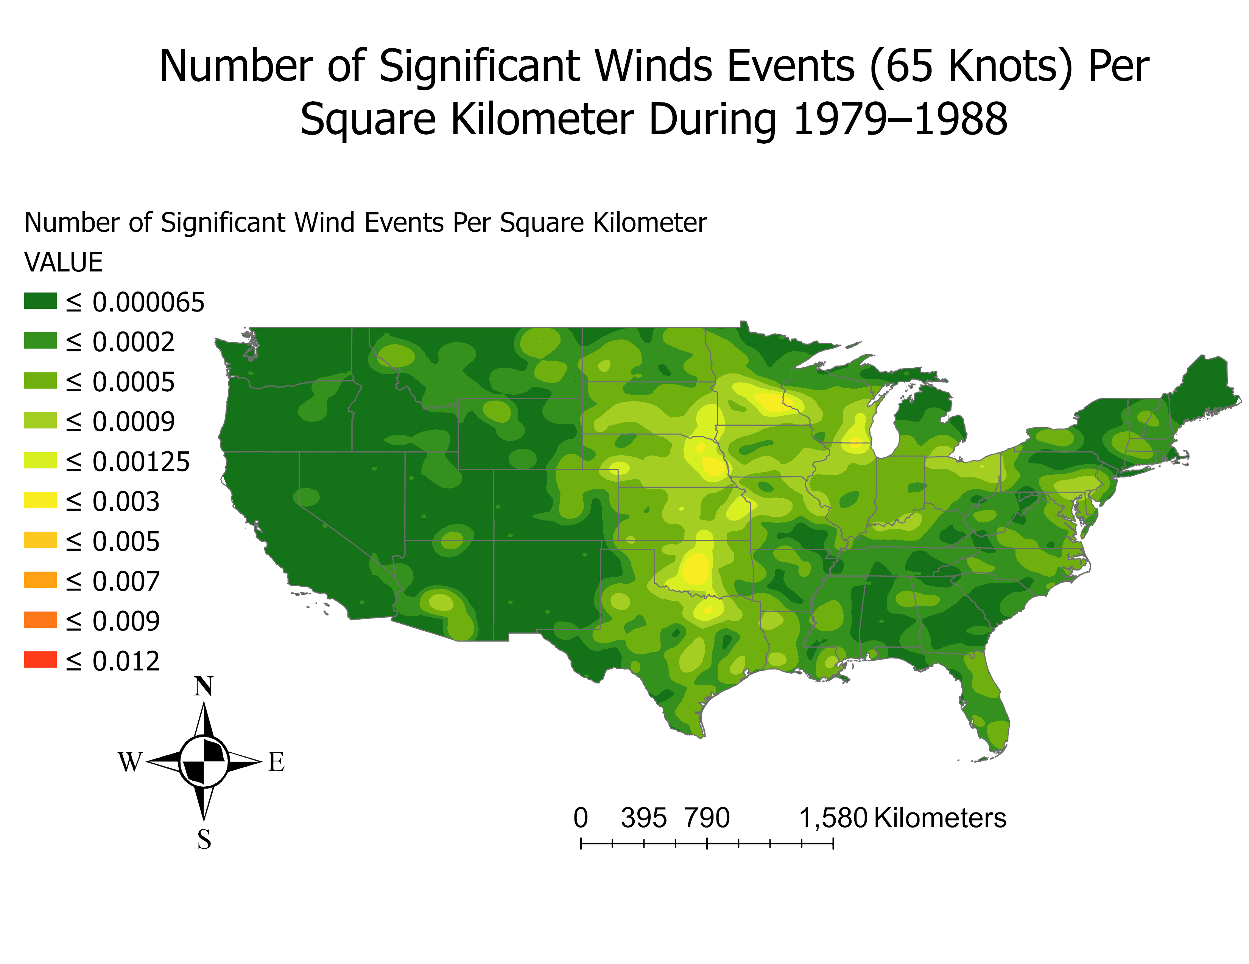

Slide 8
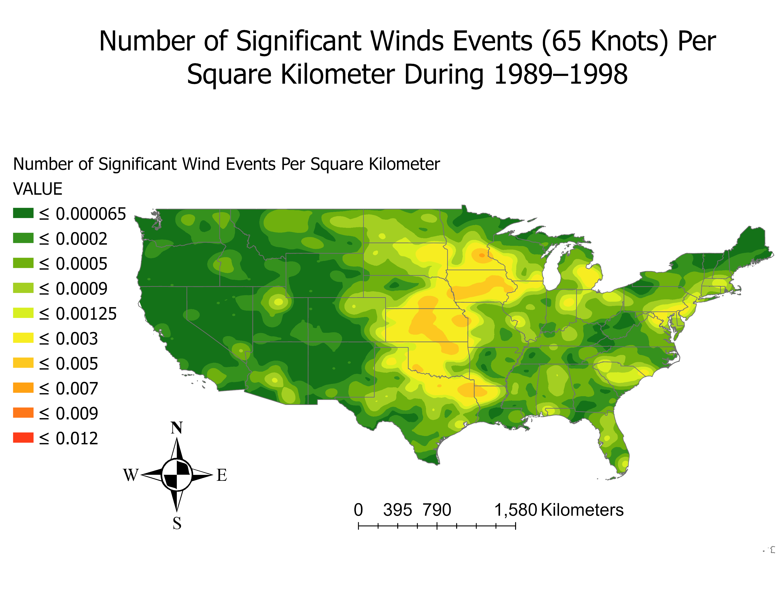

Slide 9
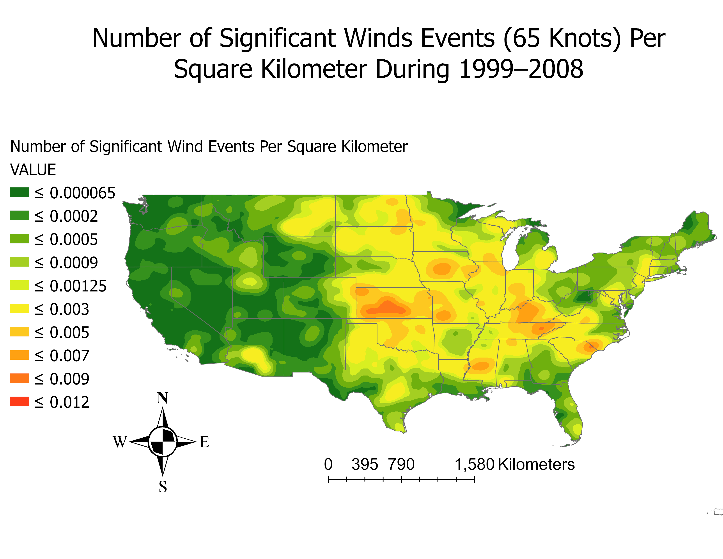

Slide 10
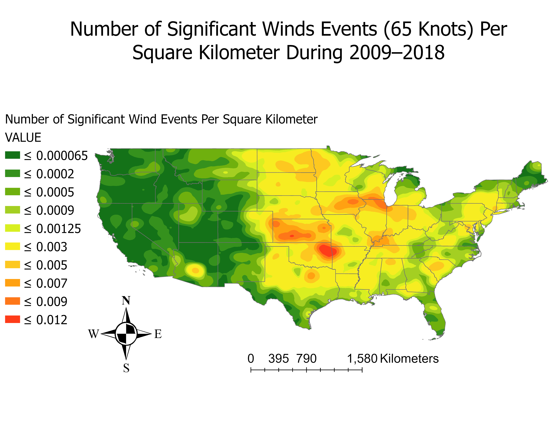

Slide 11
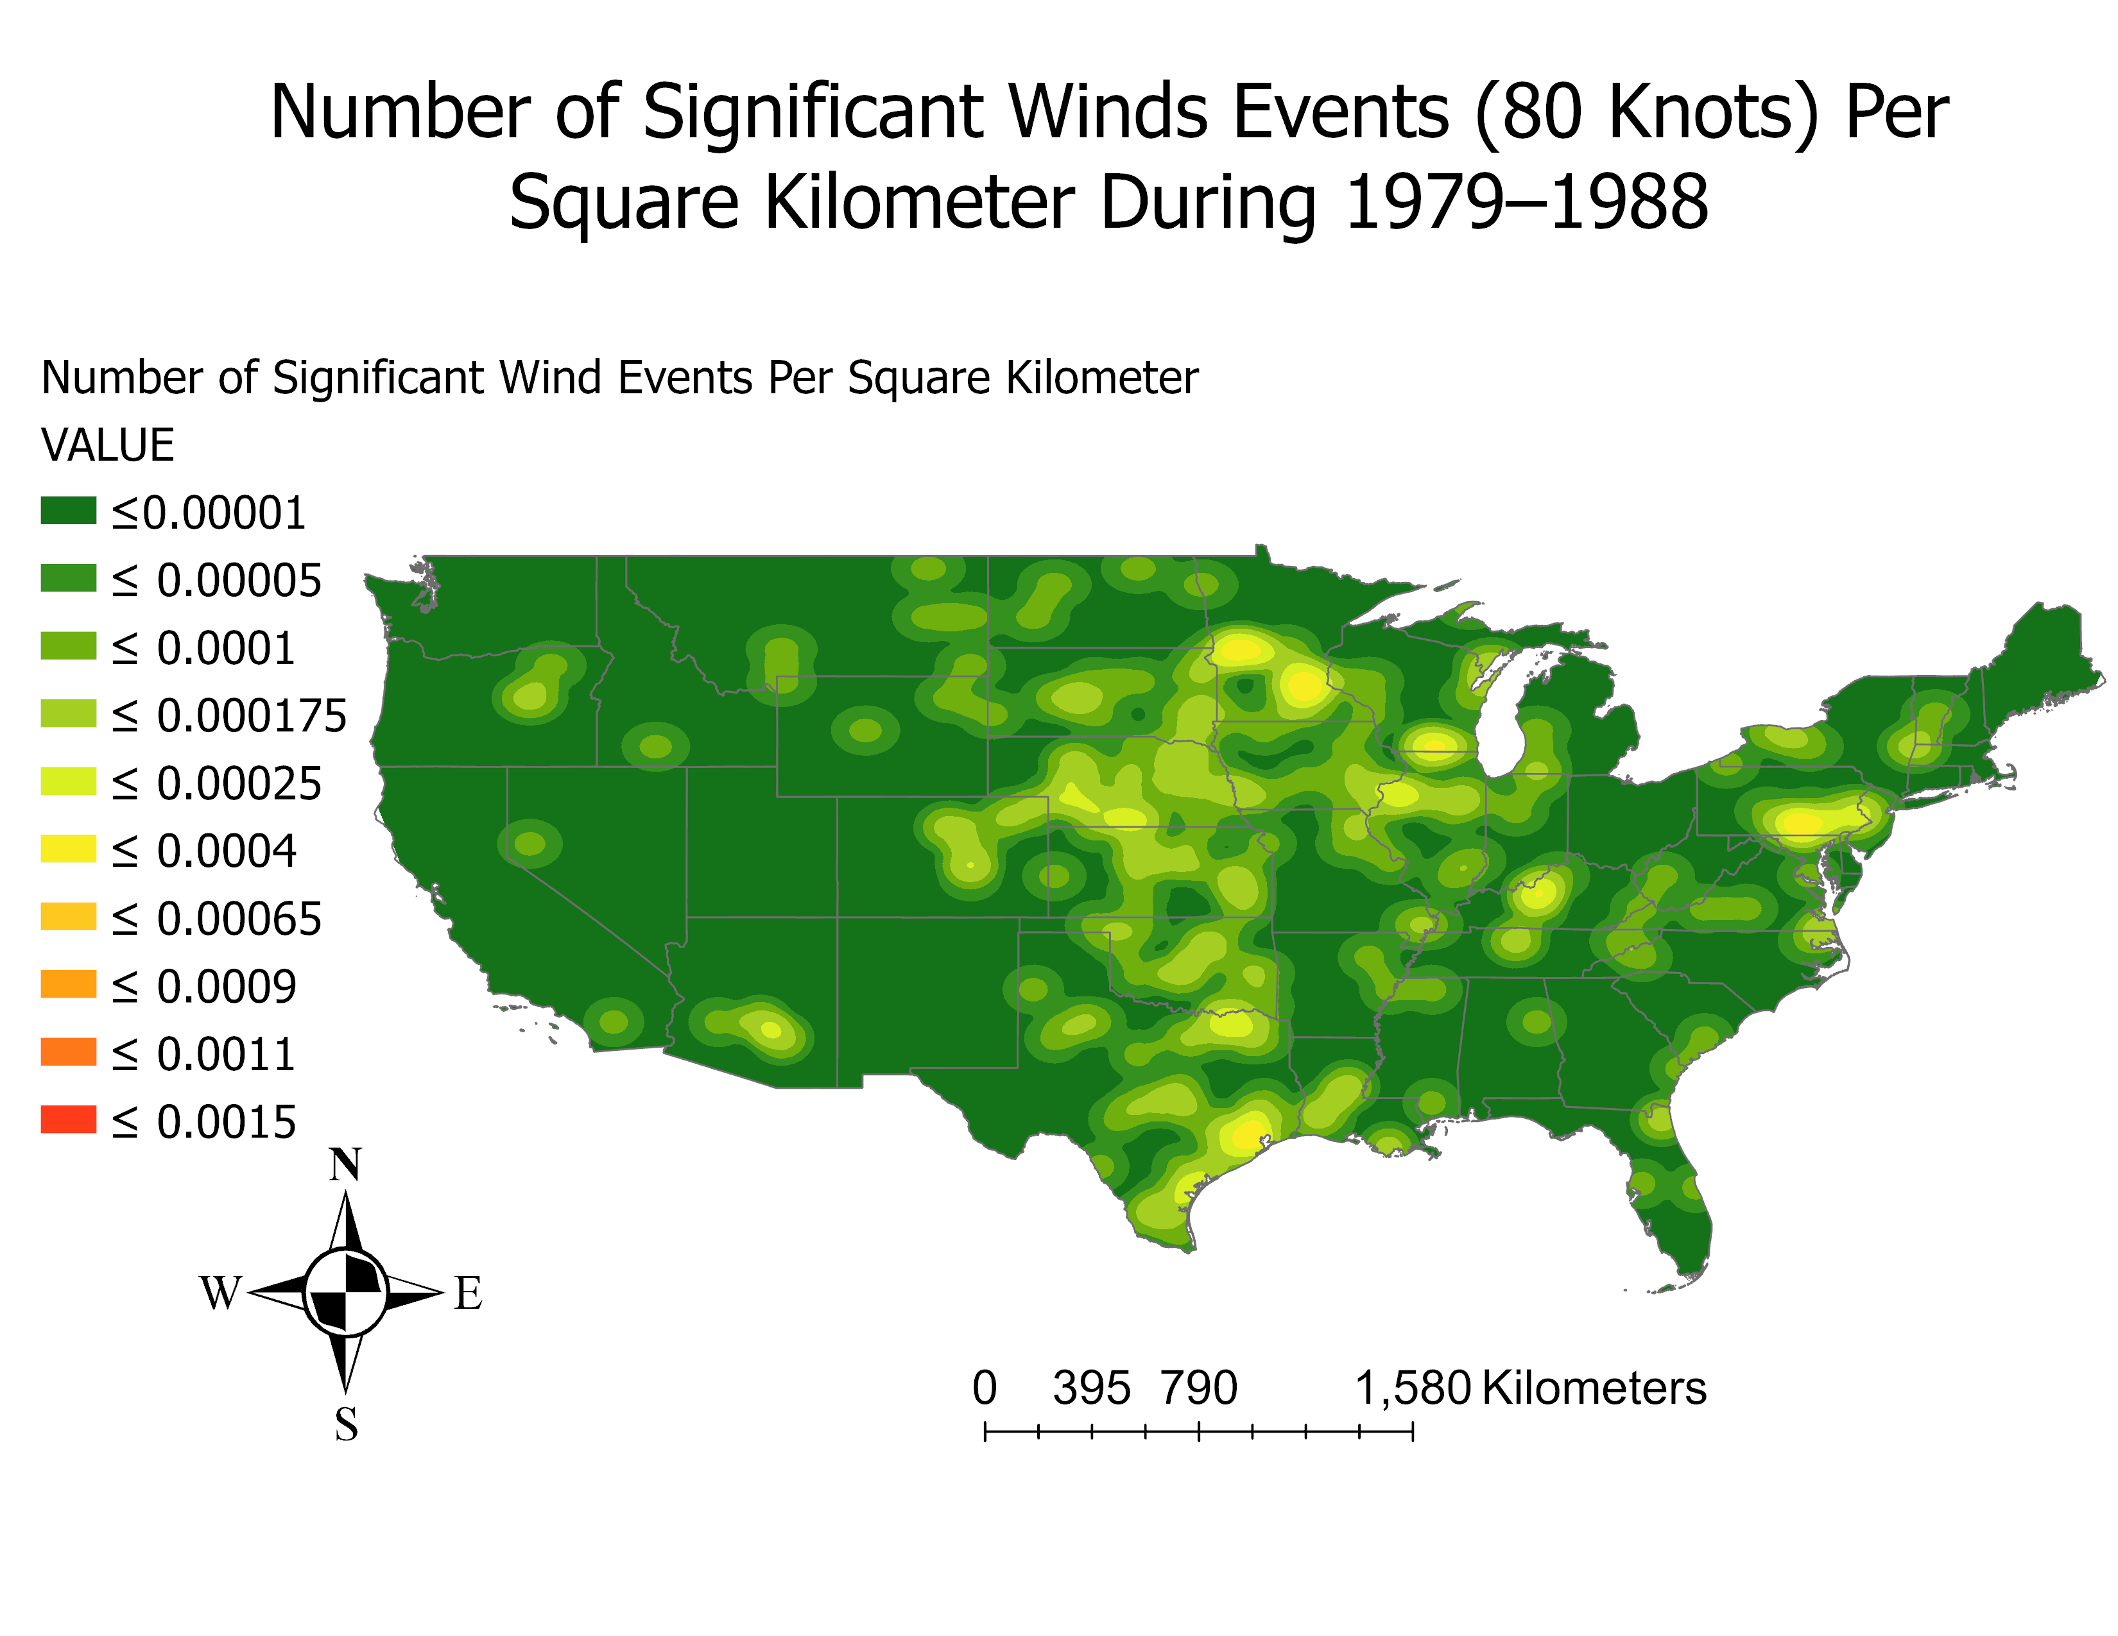

Slide 12
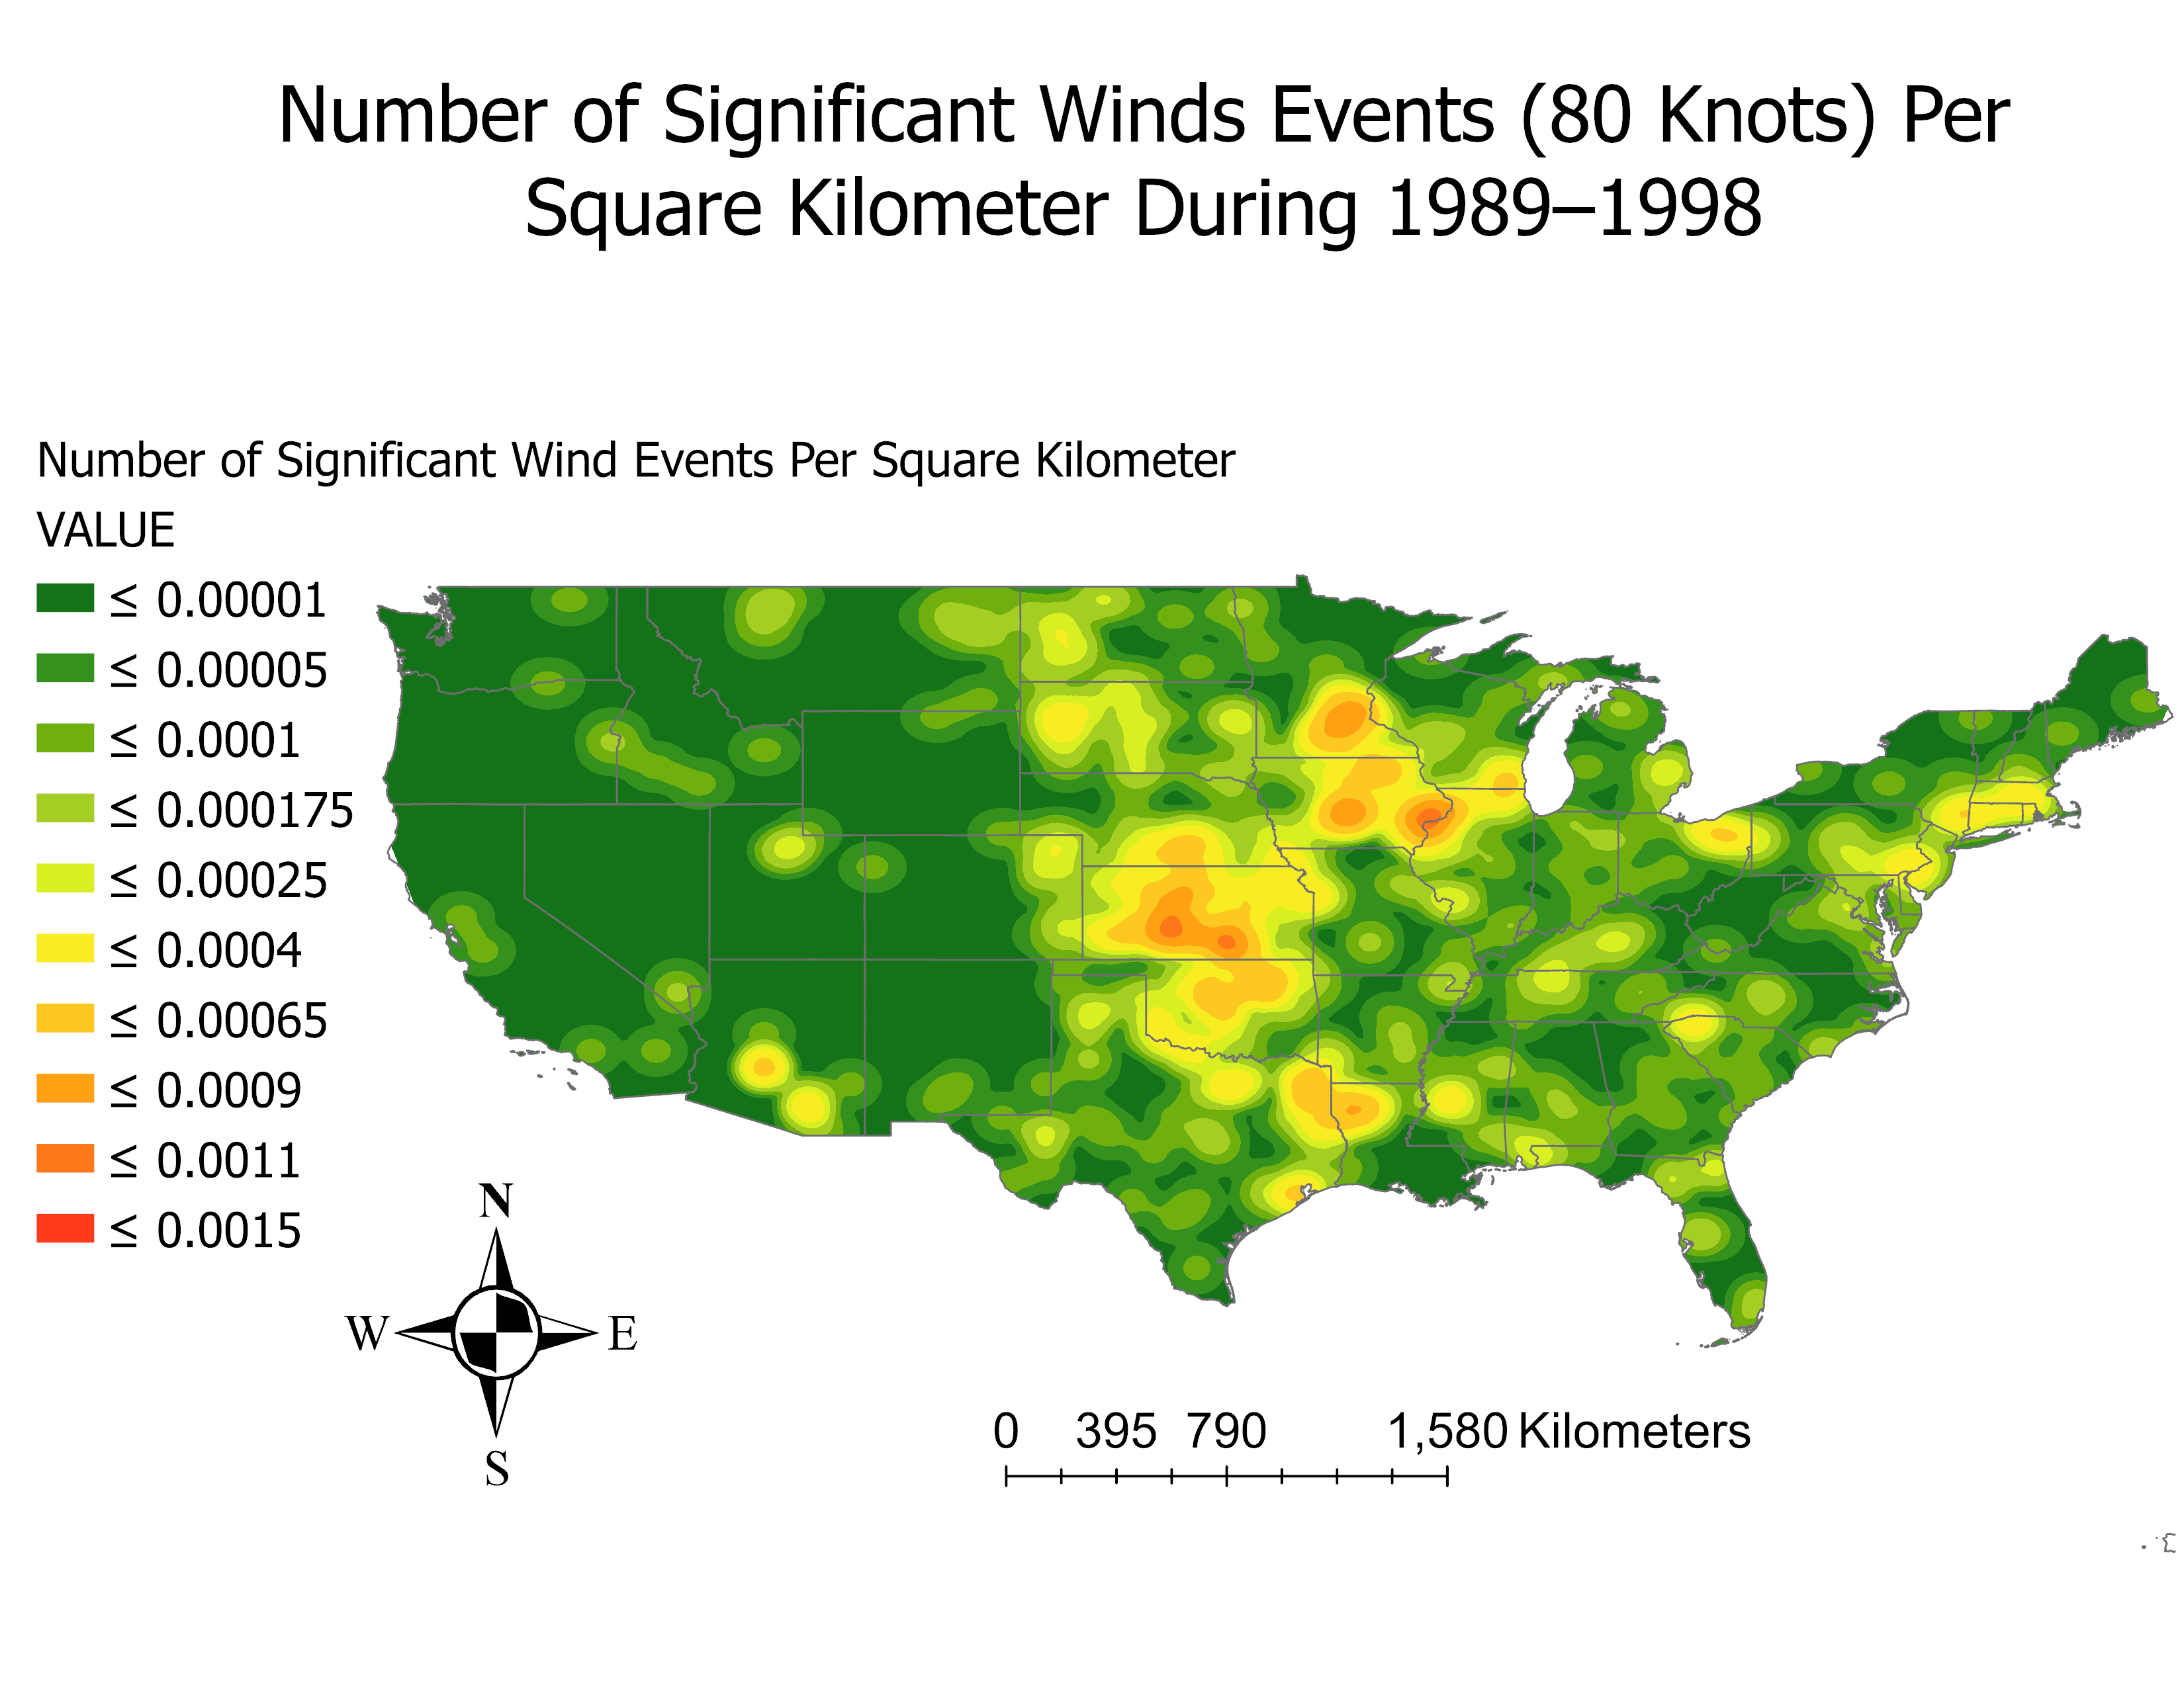

Slide 13
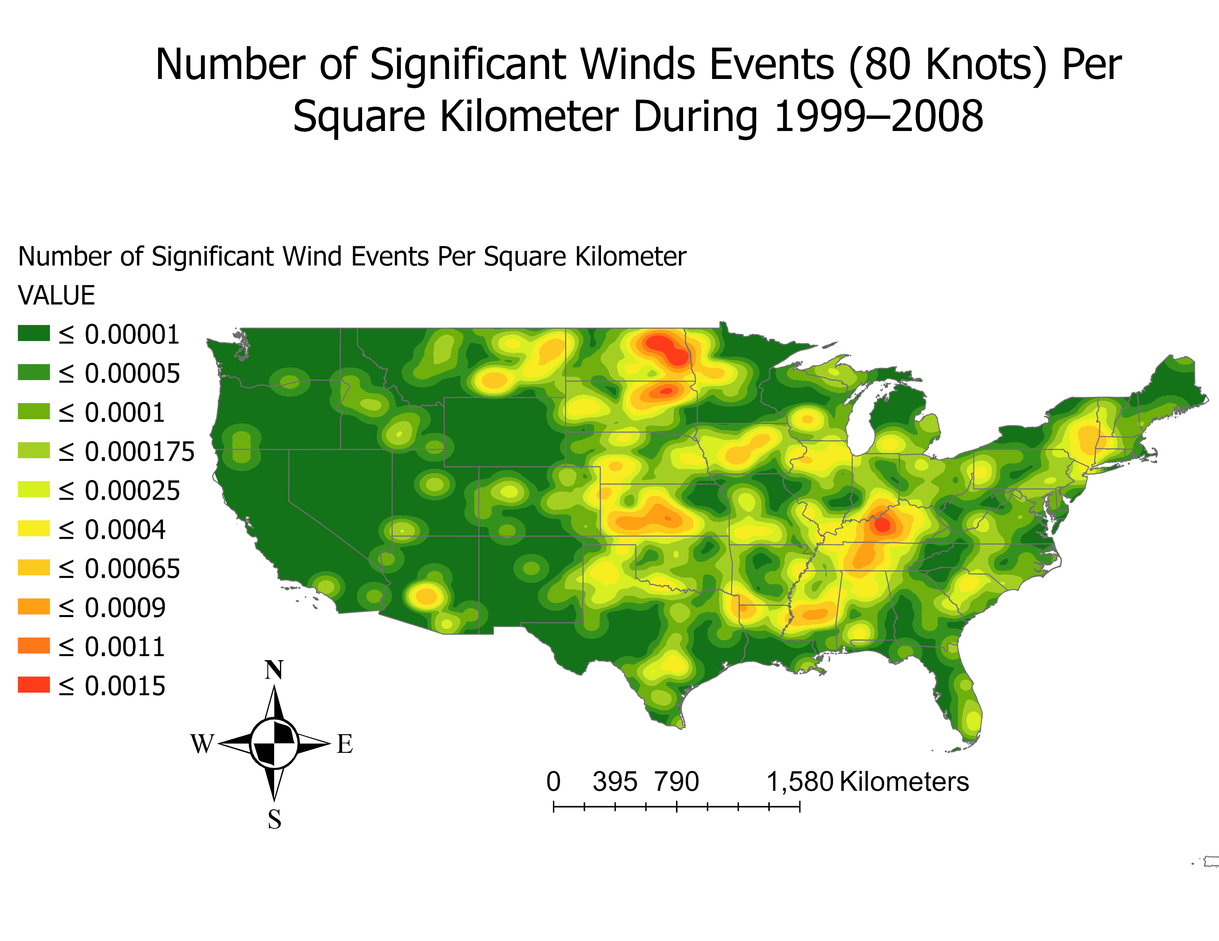

Slide 14
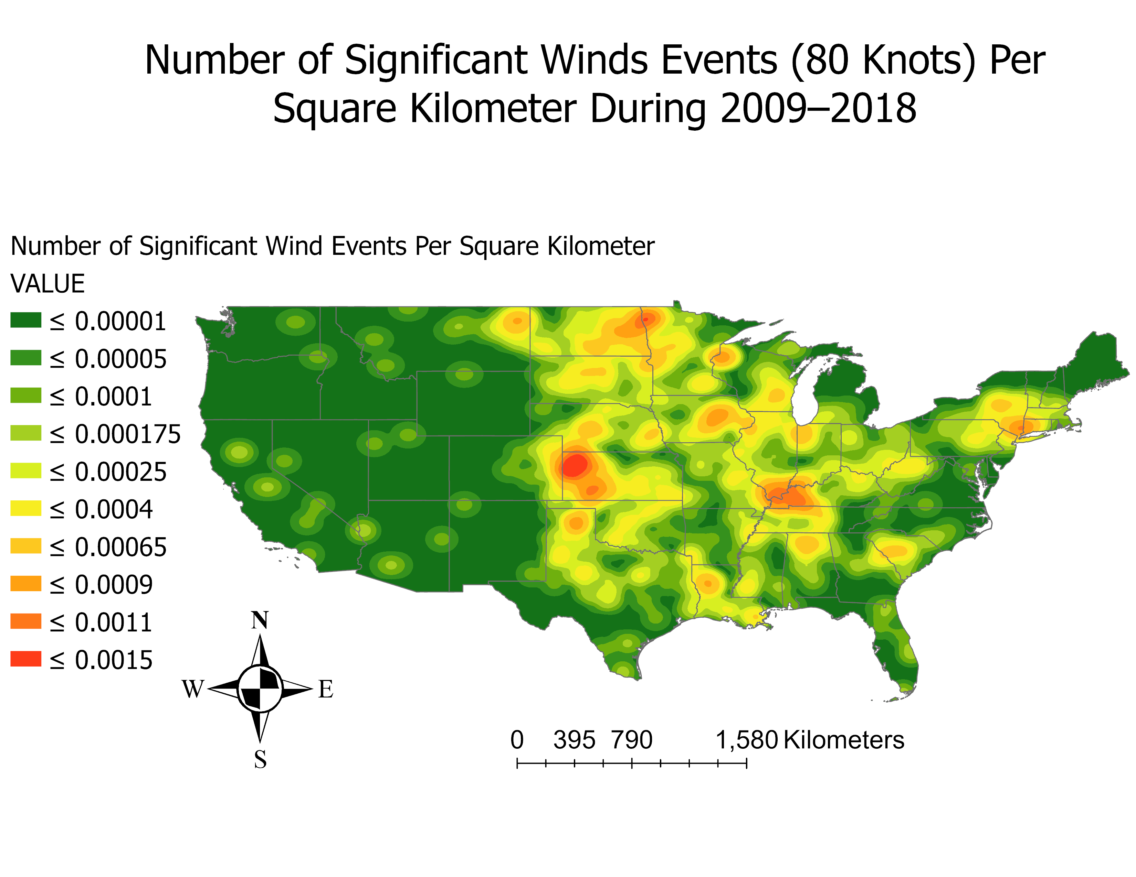

Slide 15
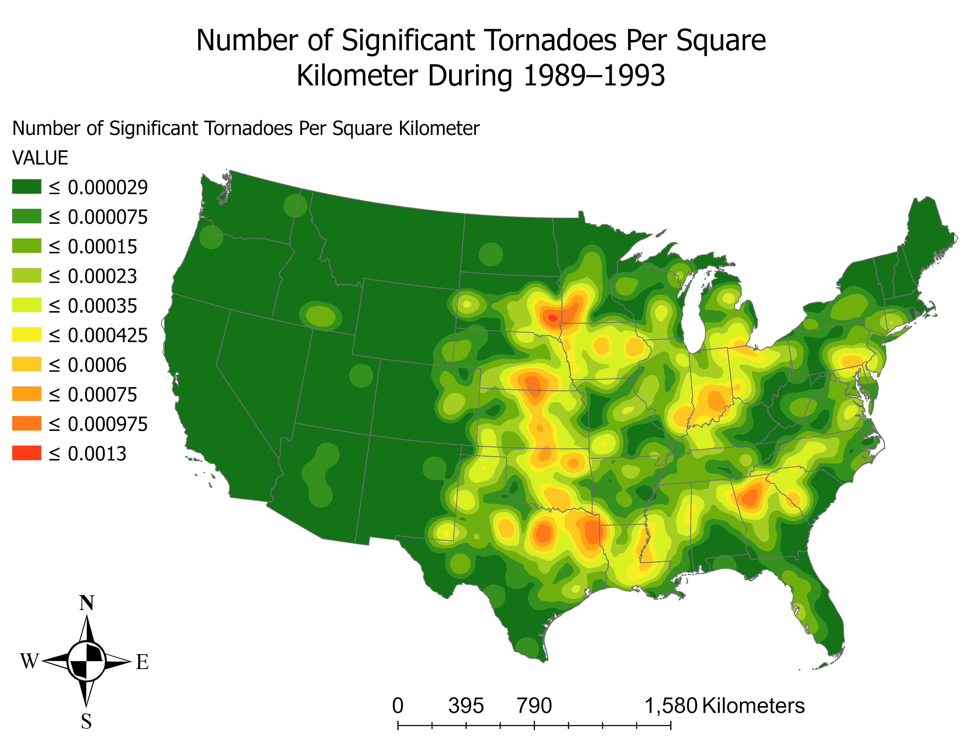

Slide 16
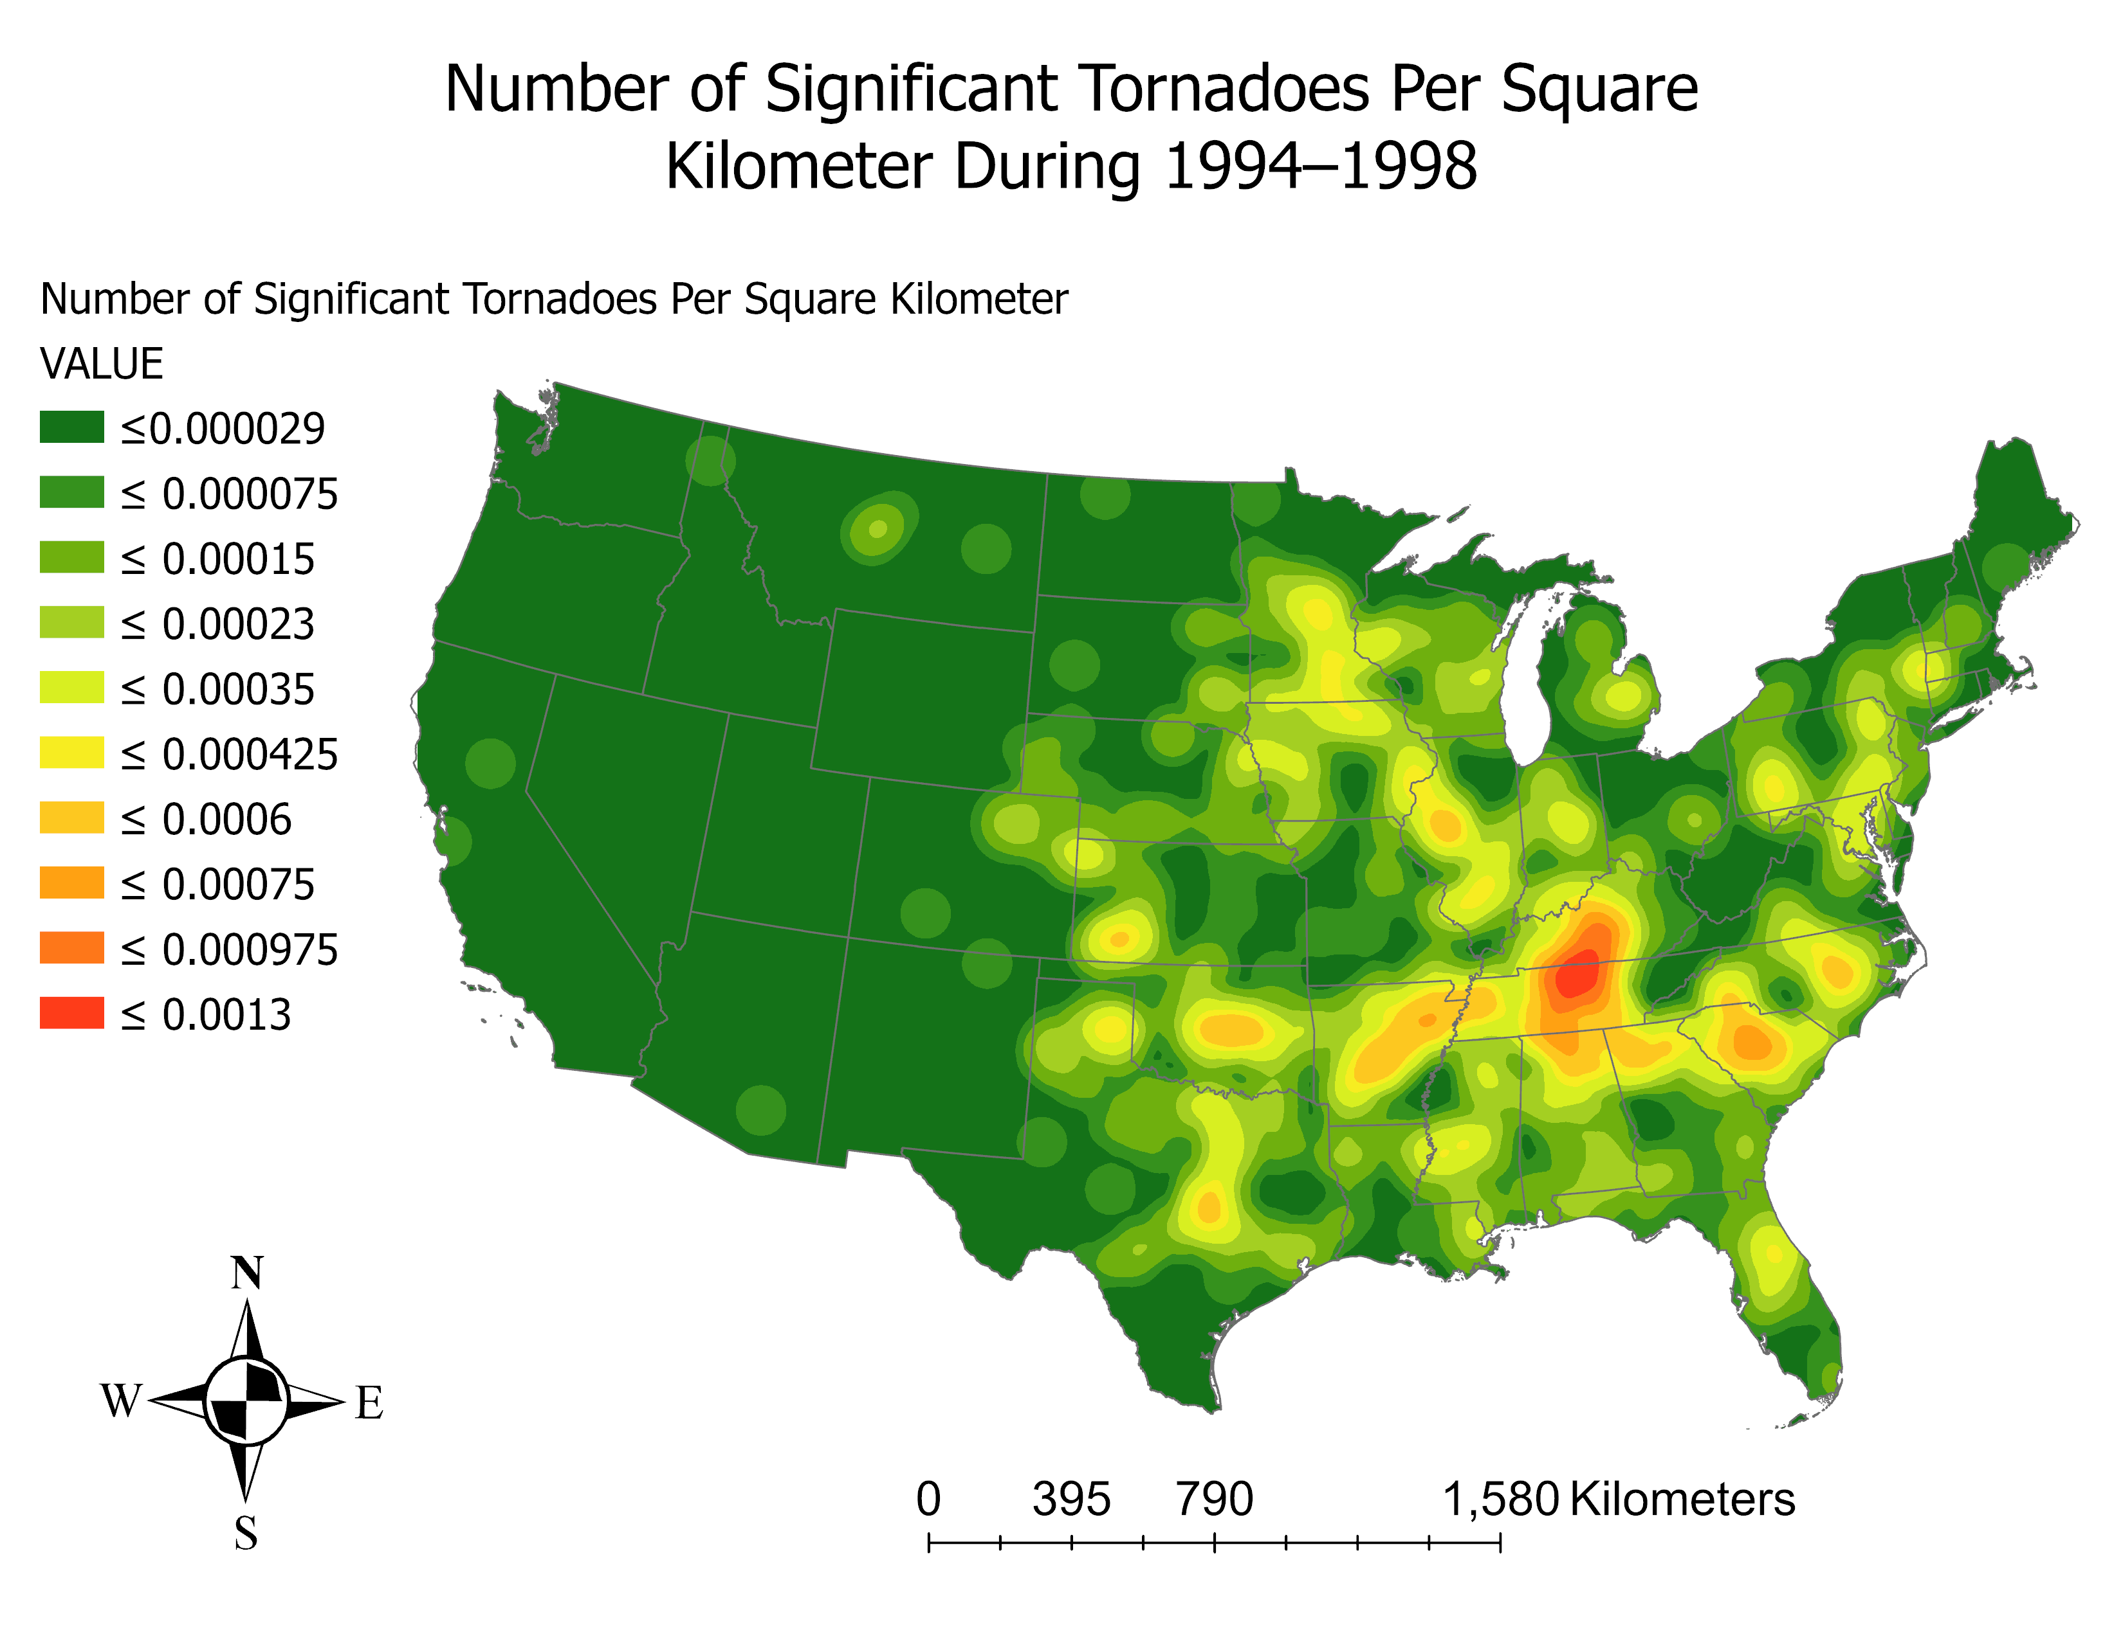

Slide 17
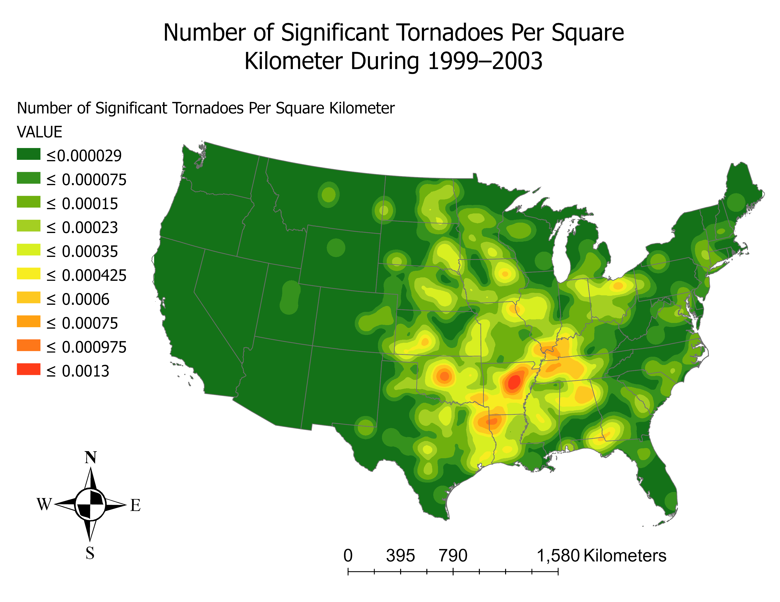

Slide 18
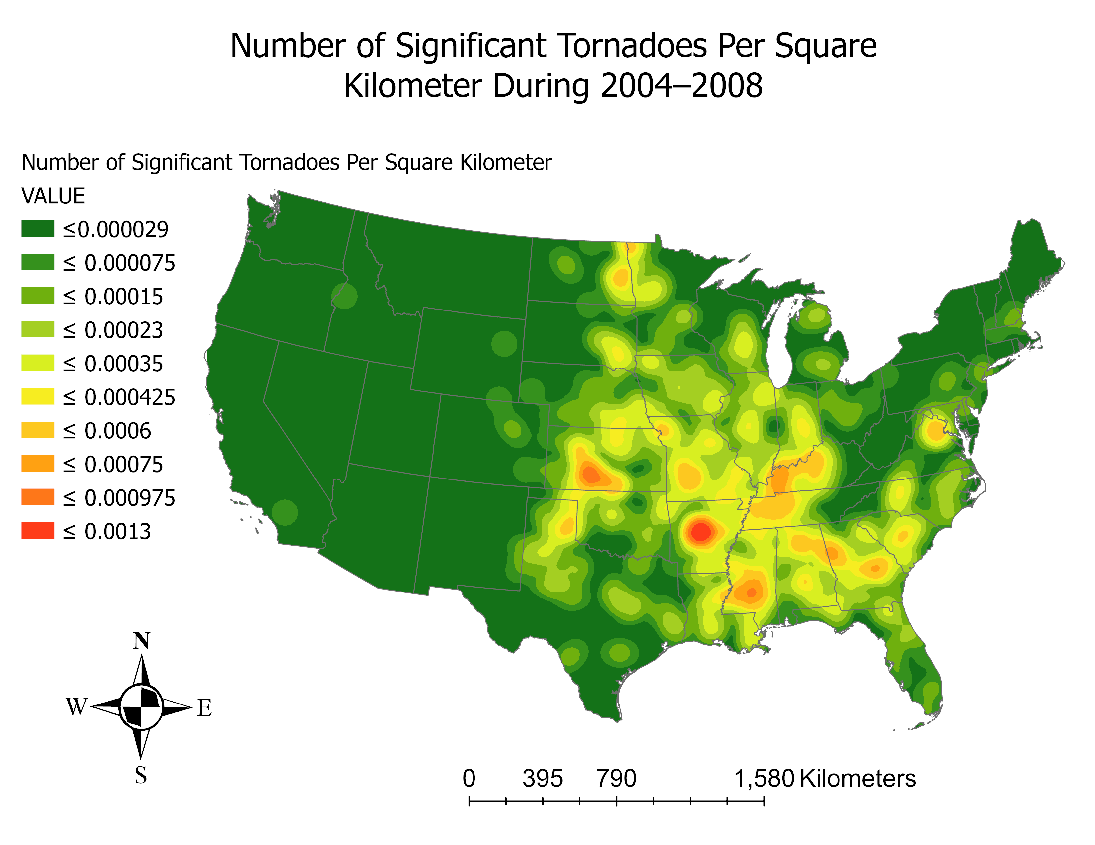

Slide 19
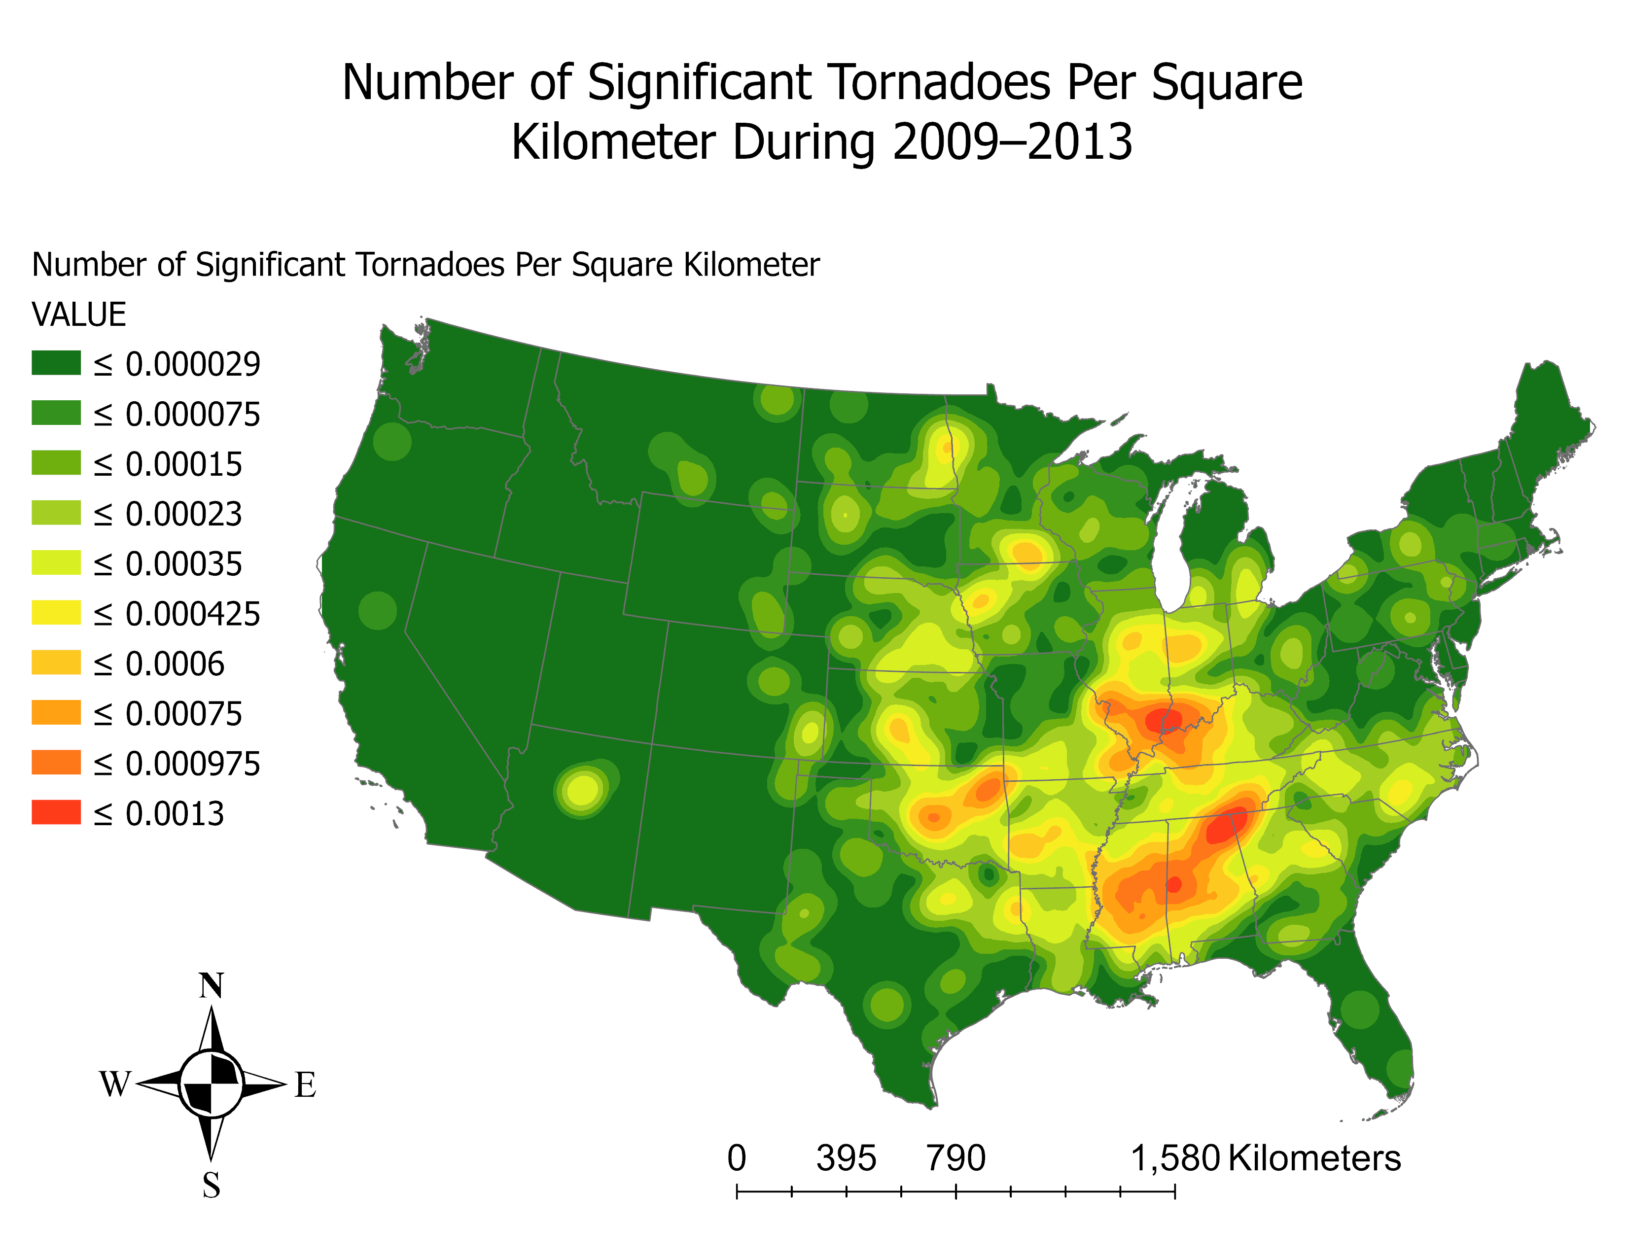

Slide 20
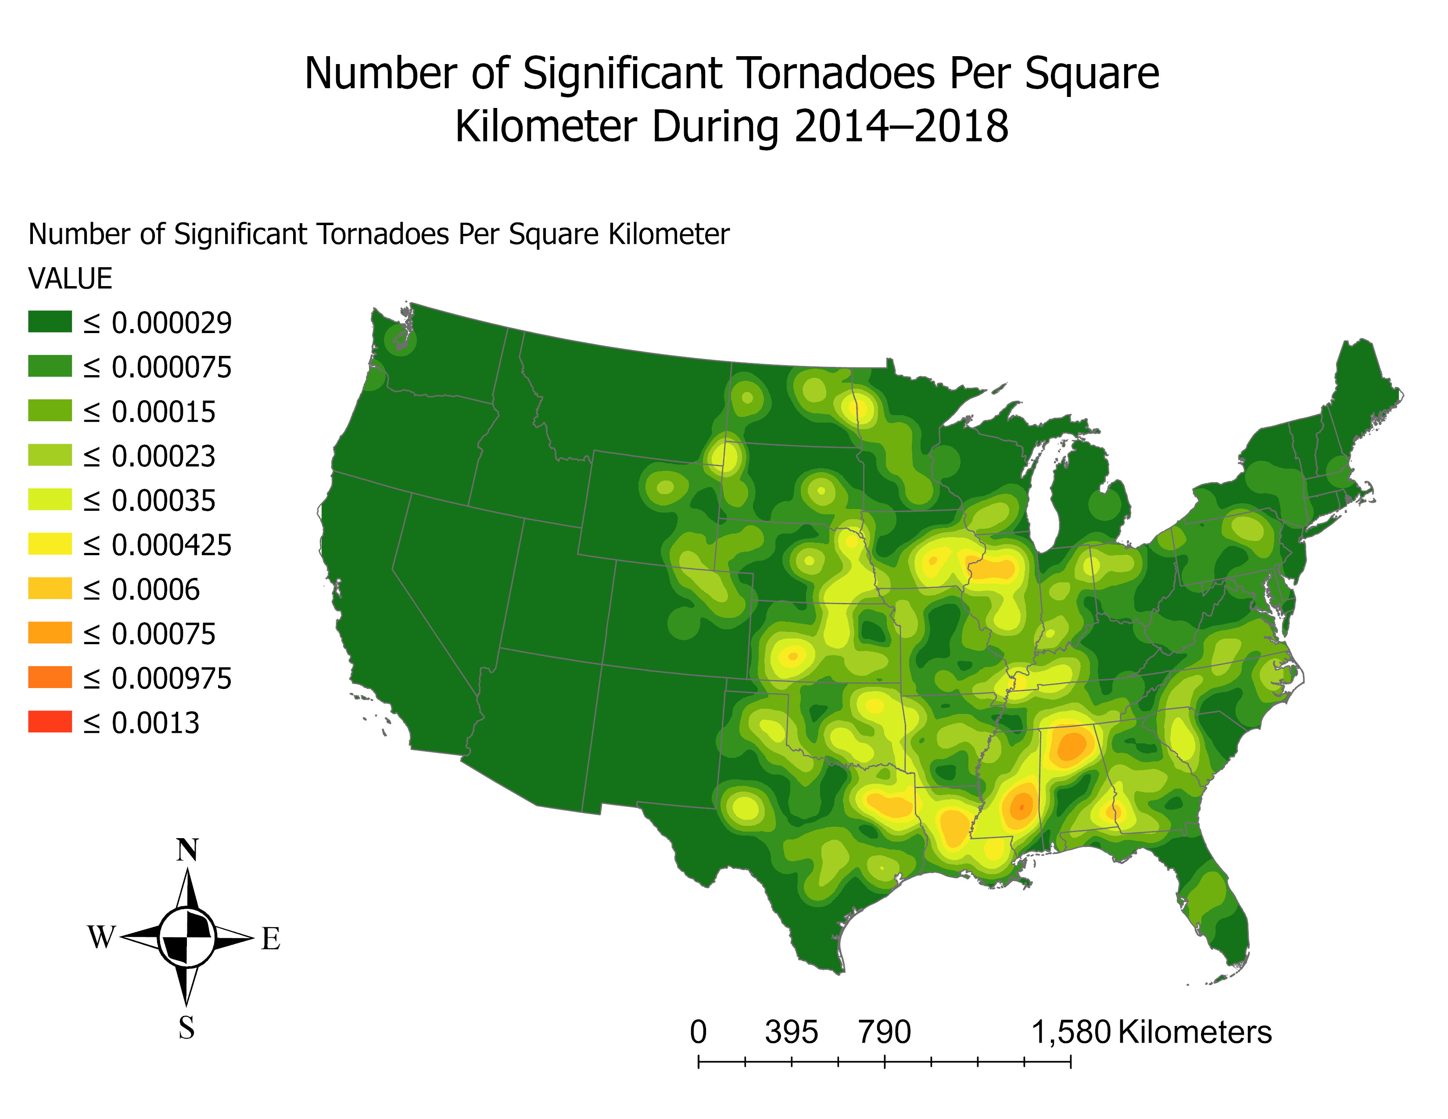

Slide 21
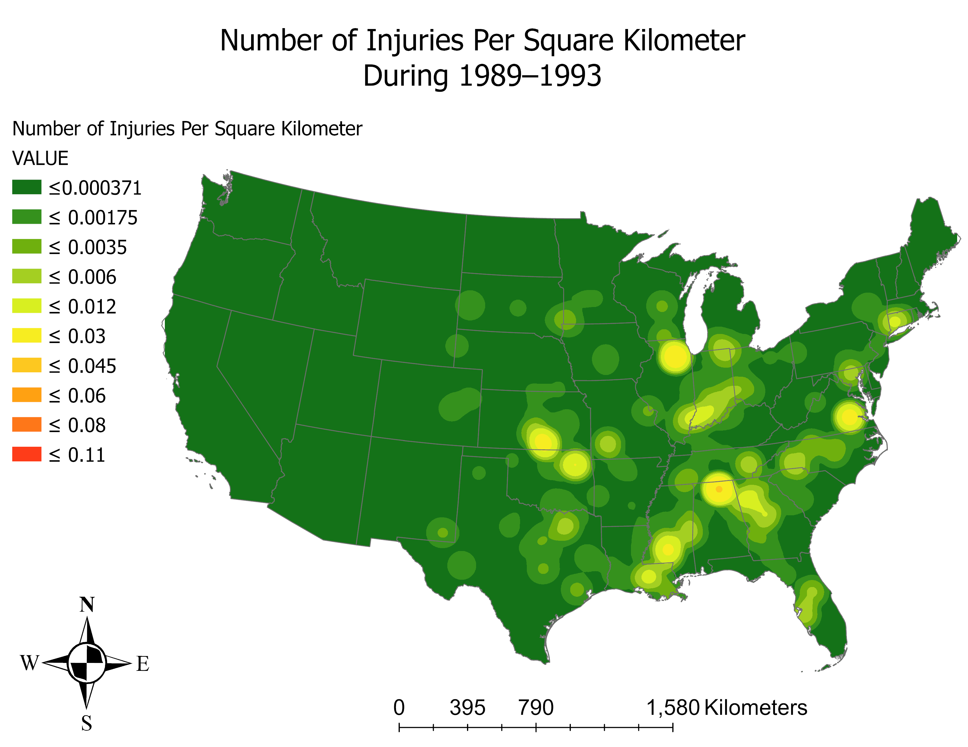

Slide 22
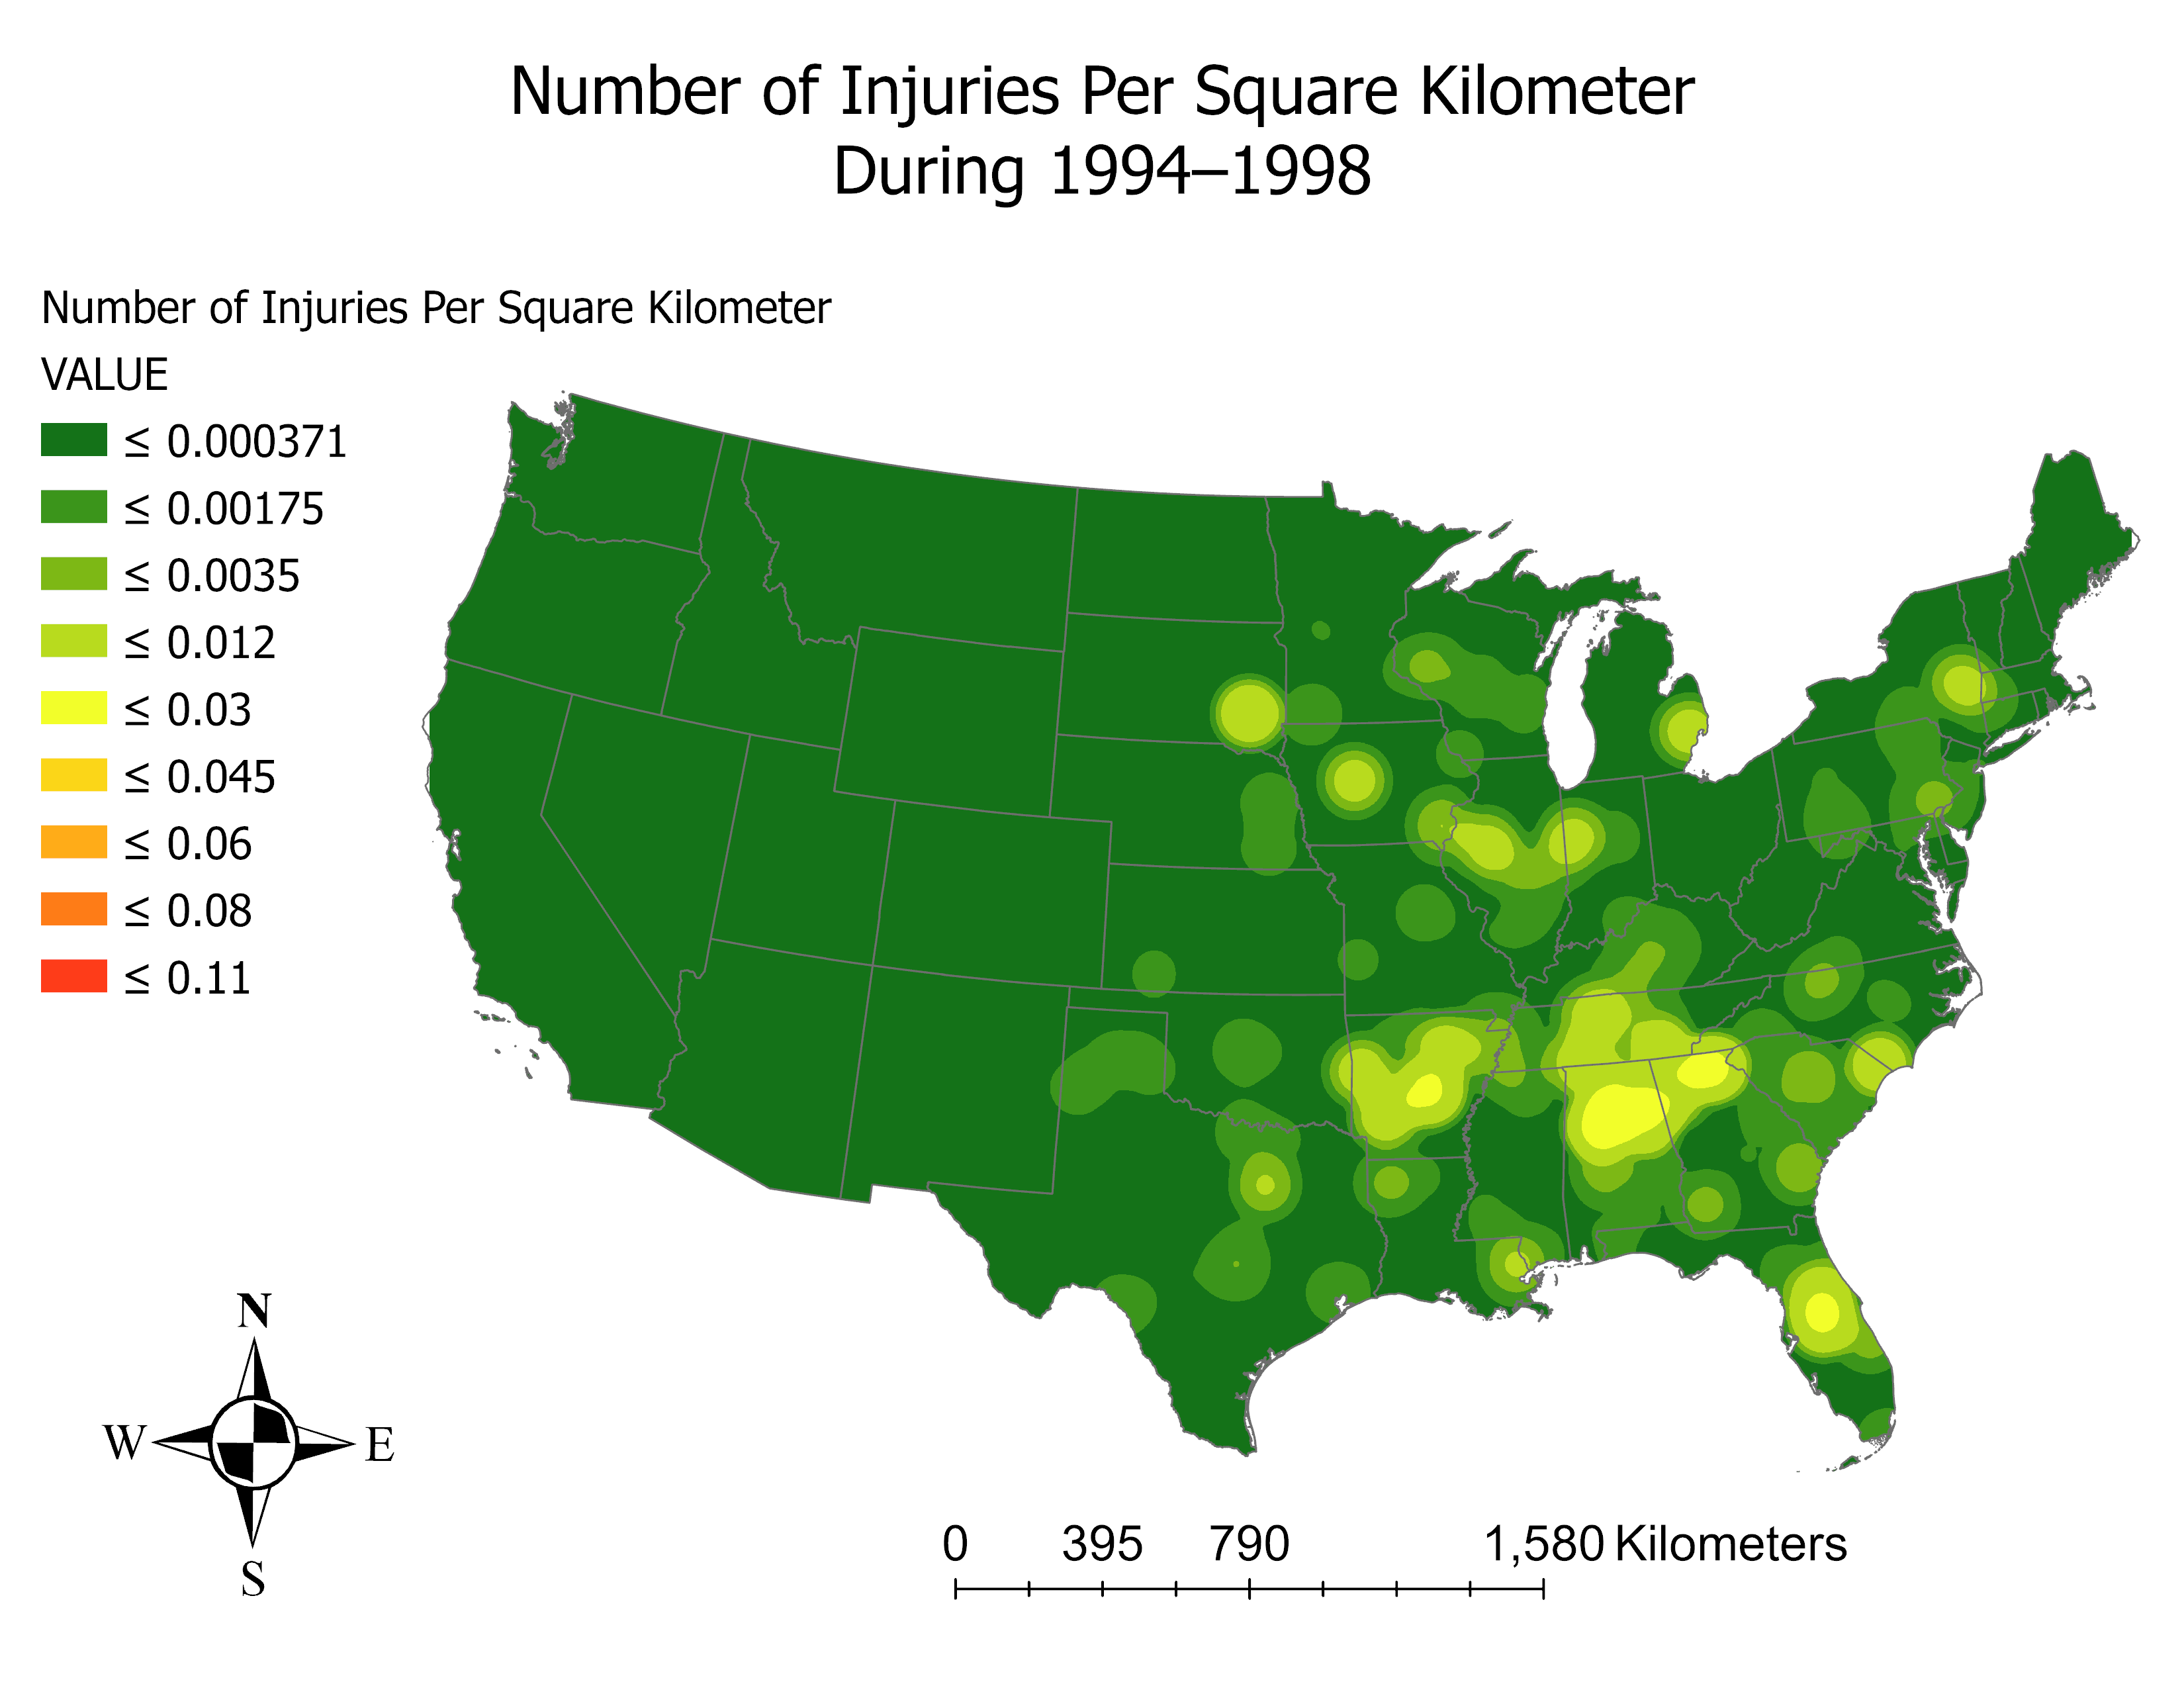

Slide 23
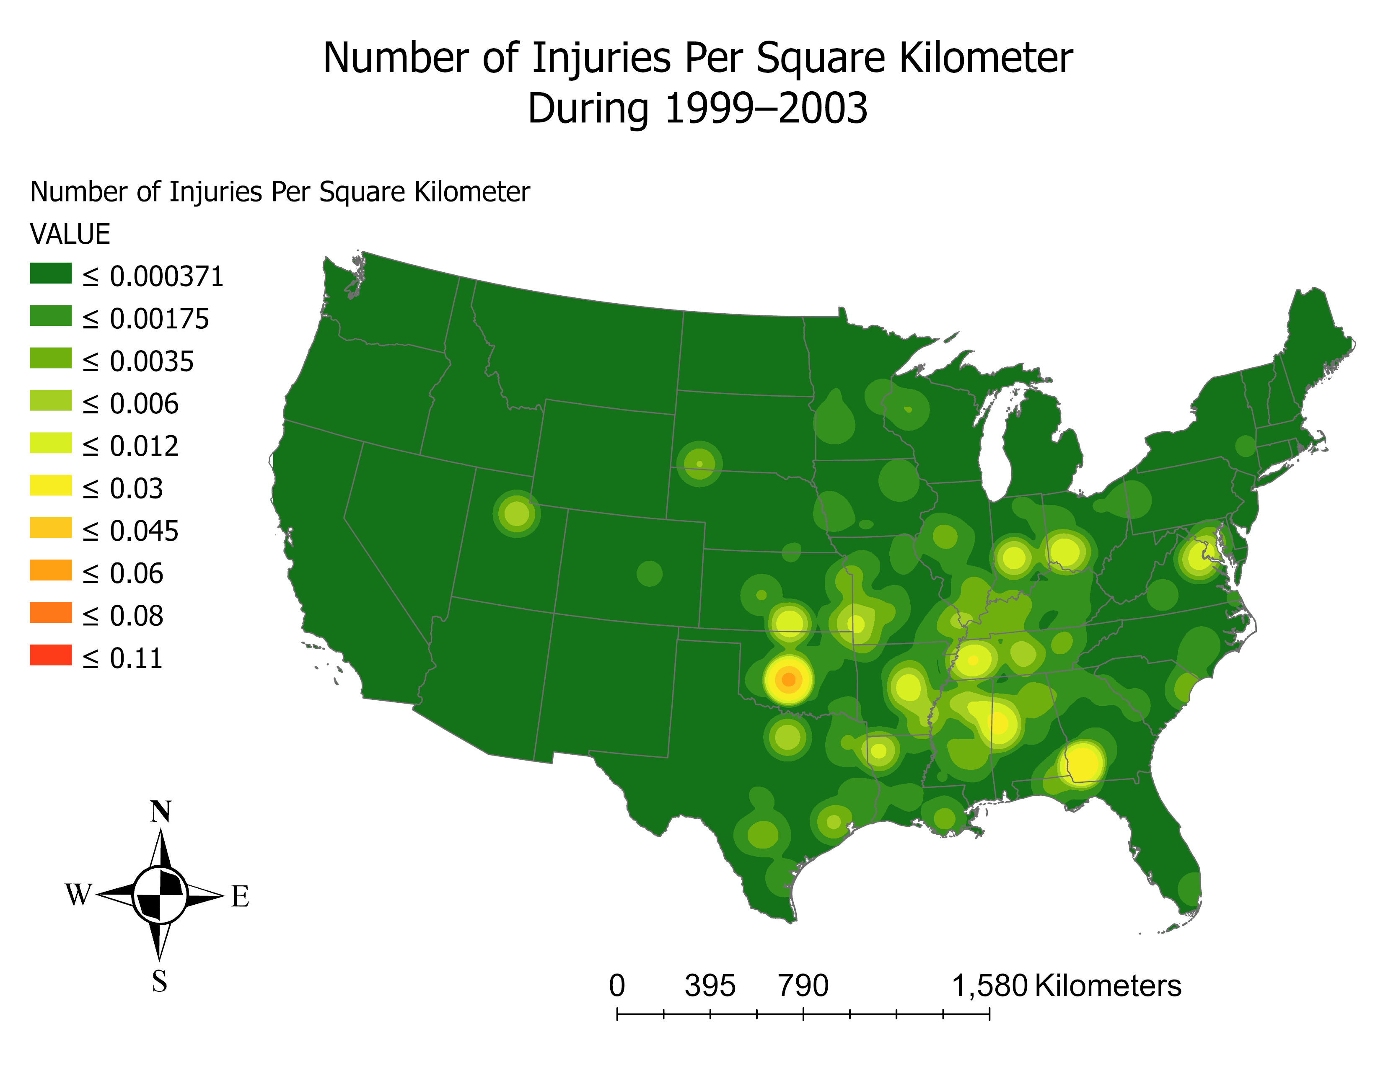

Slide 24
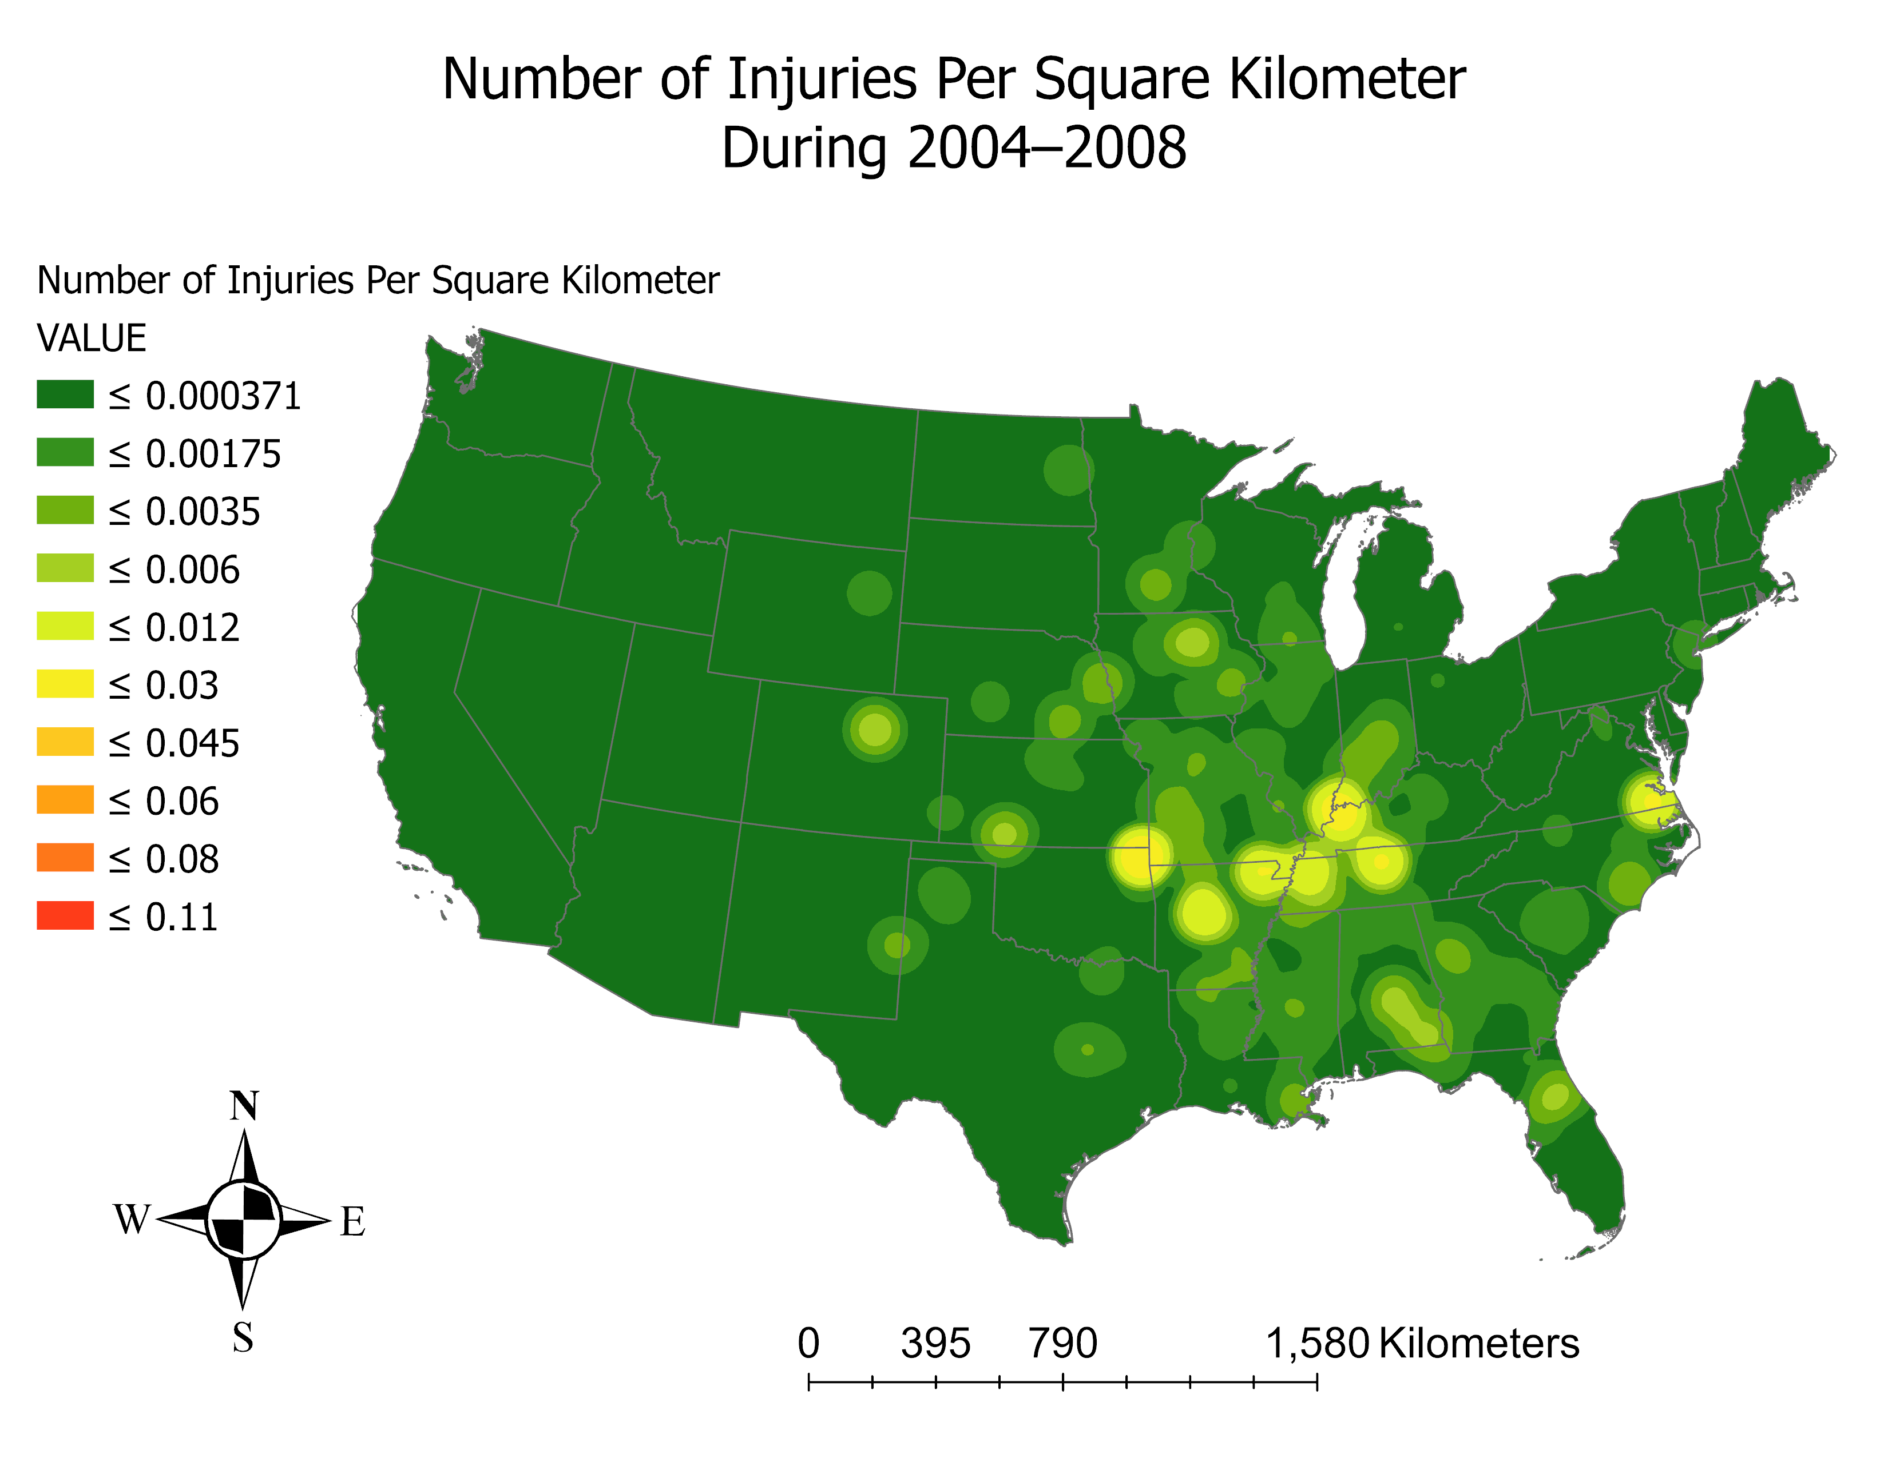

Slide 25
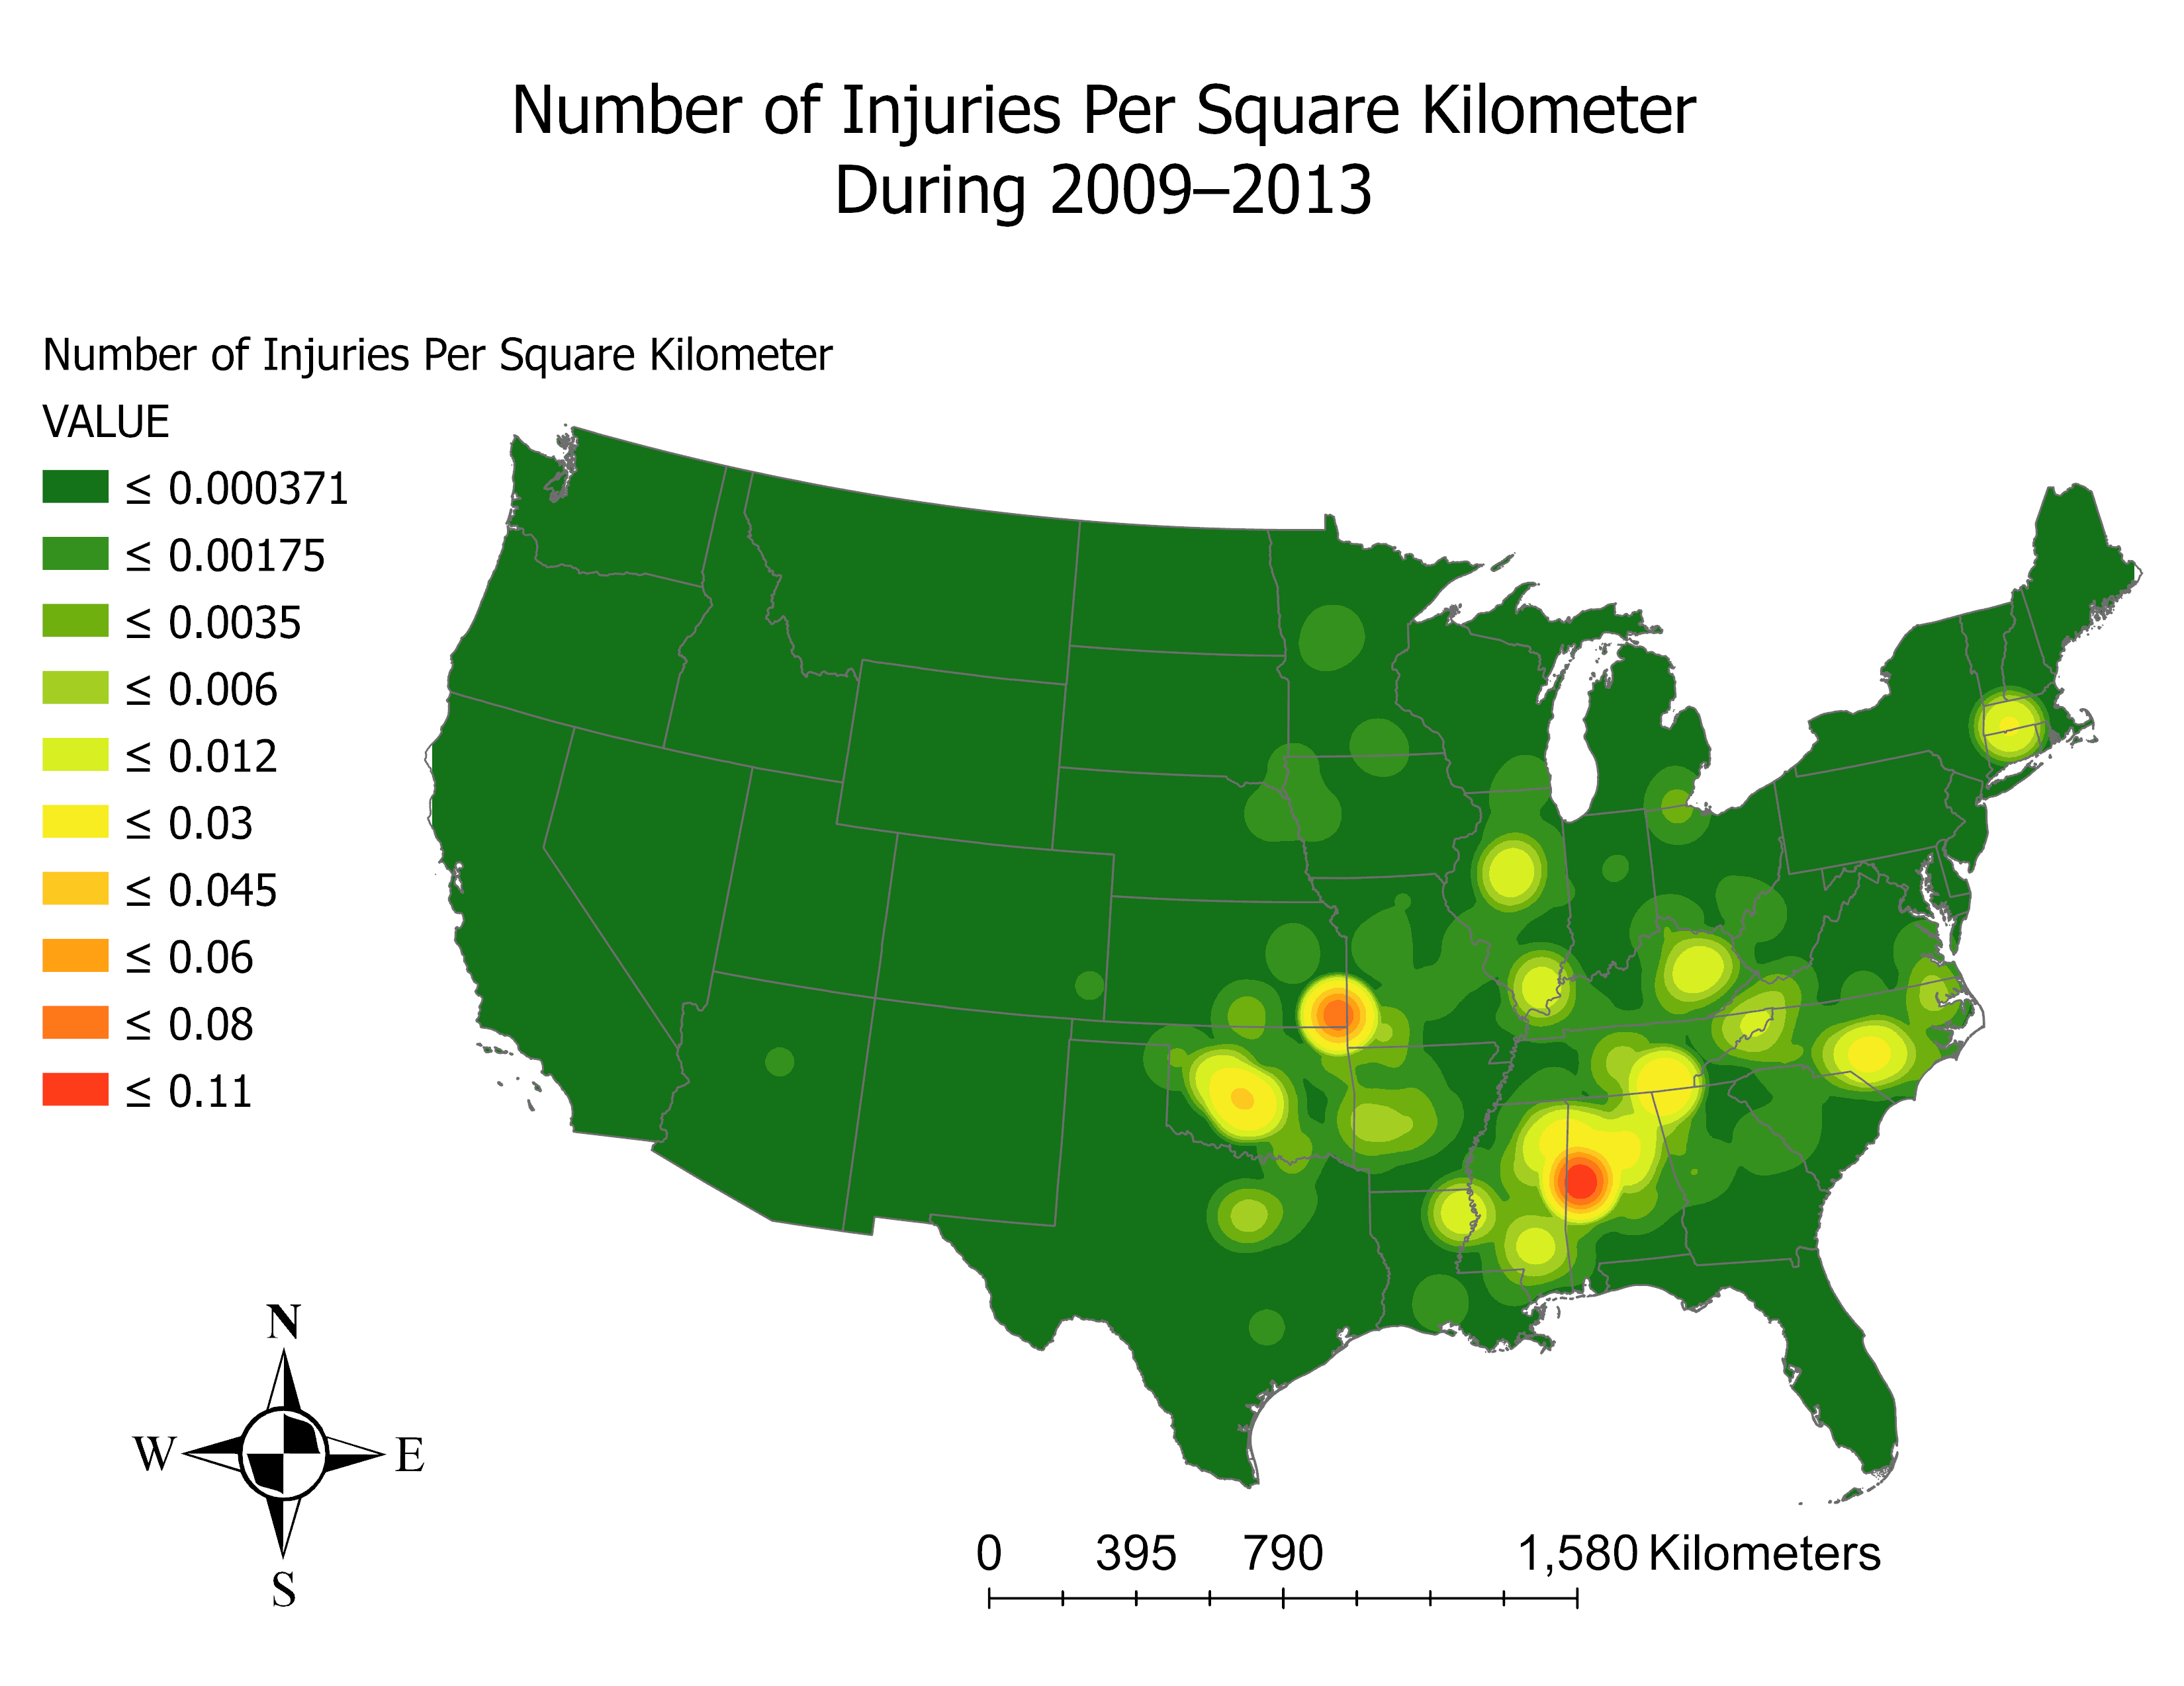

Slide 26
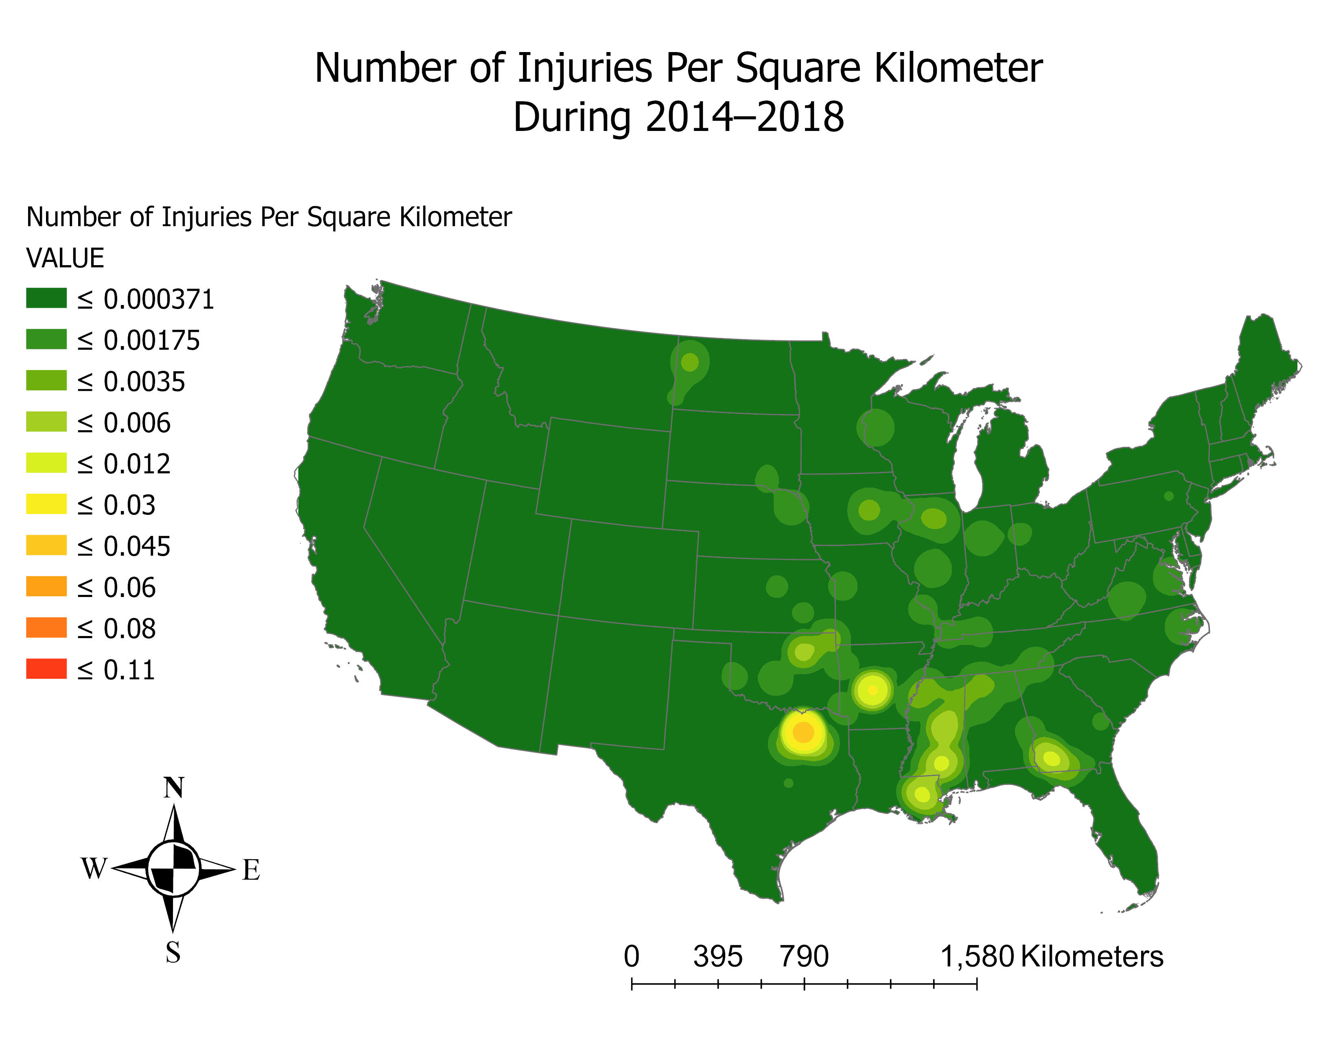

Slide 27
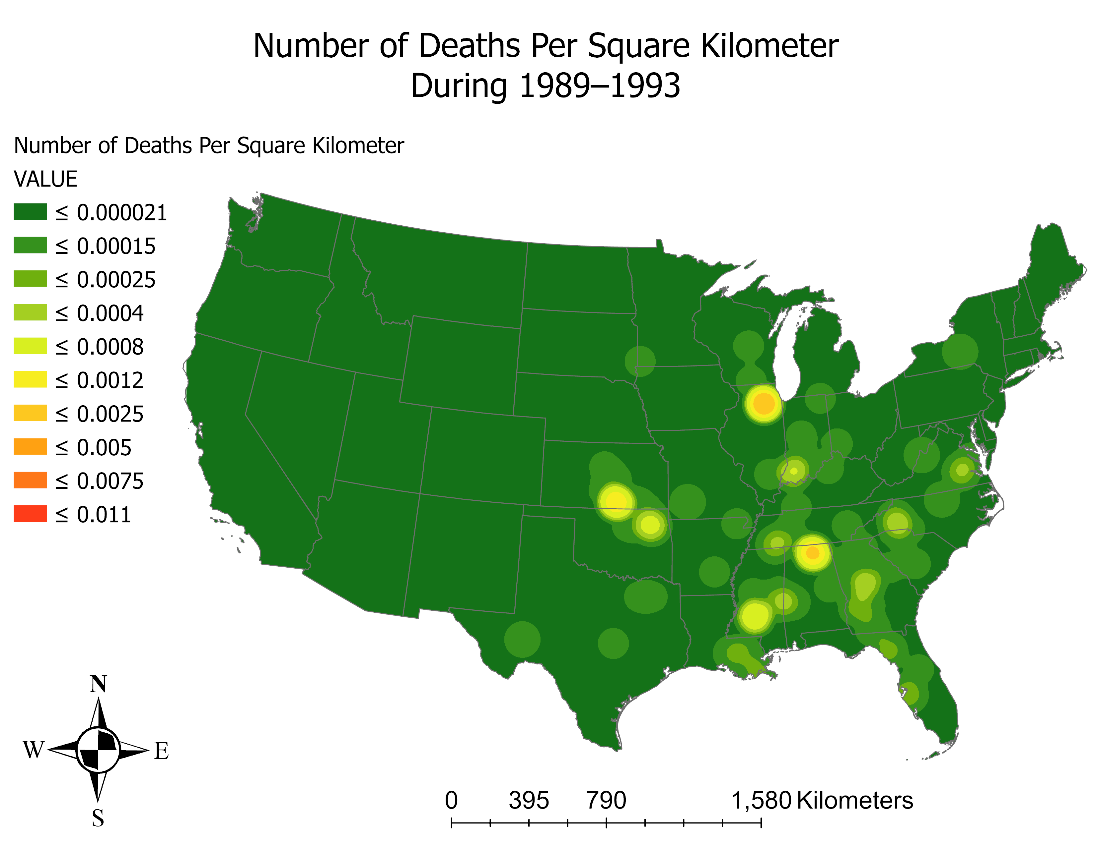

Slide 28
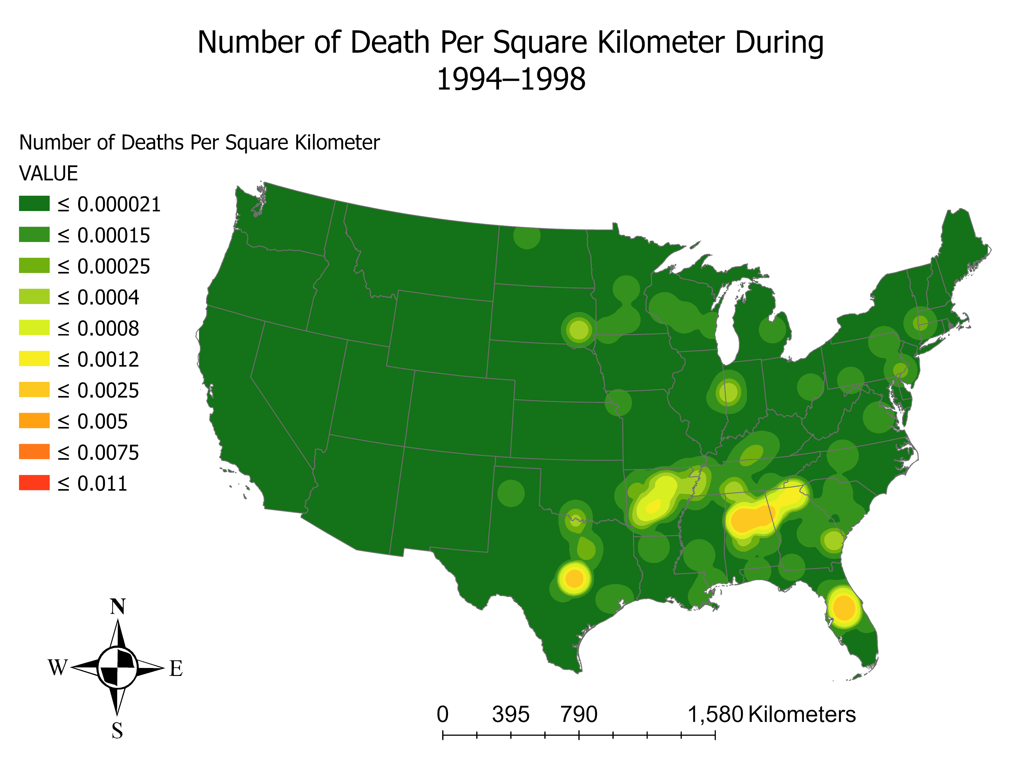

Slide 29


Slide 30
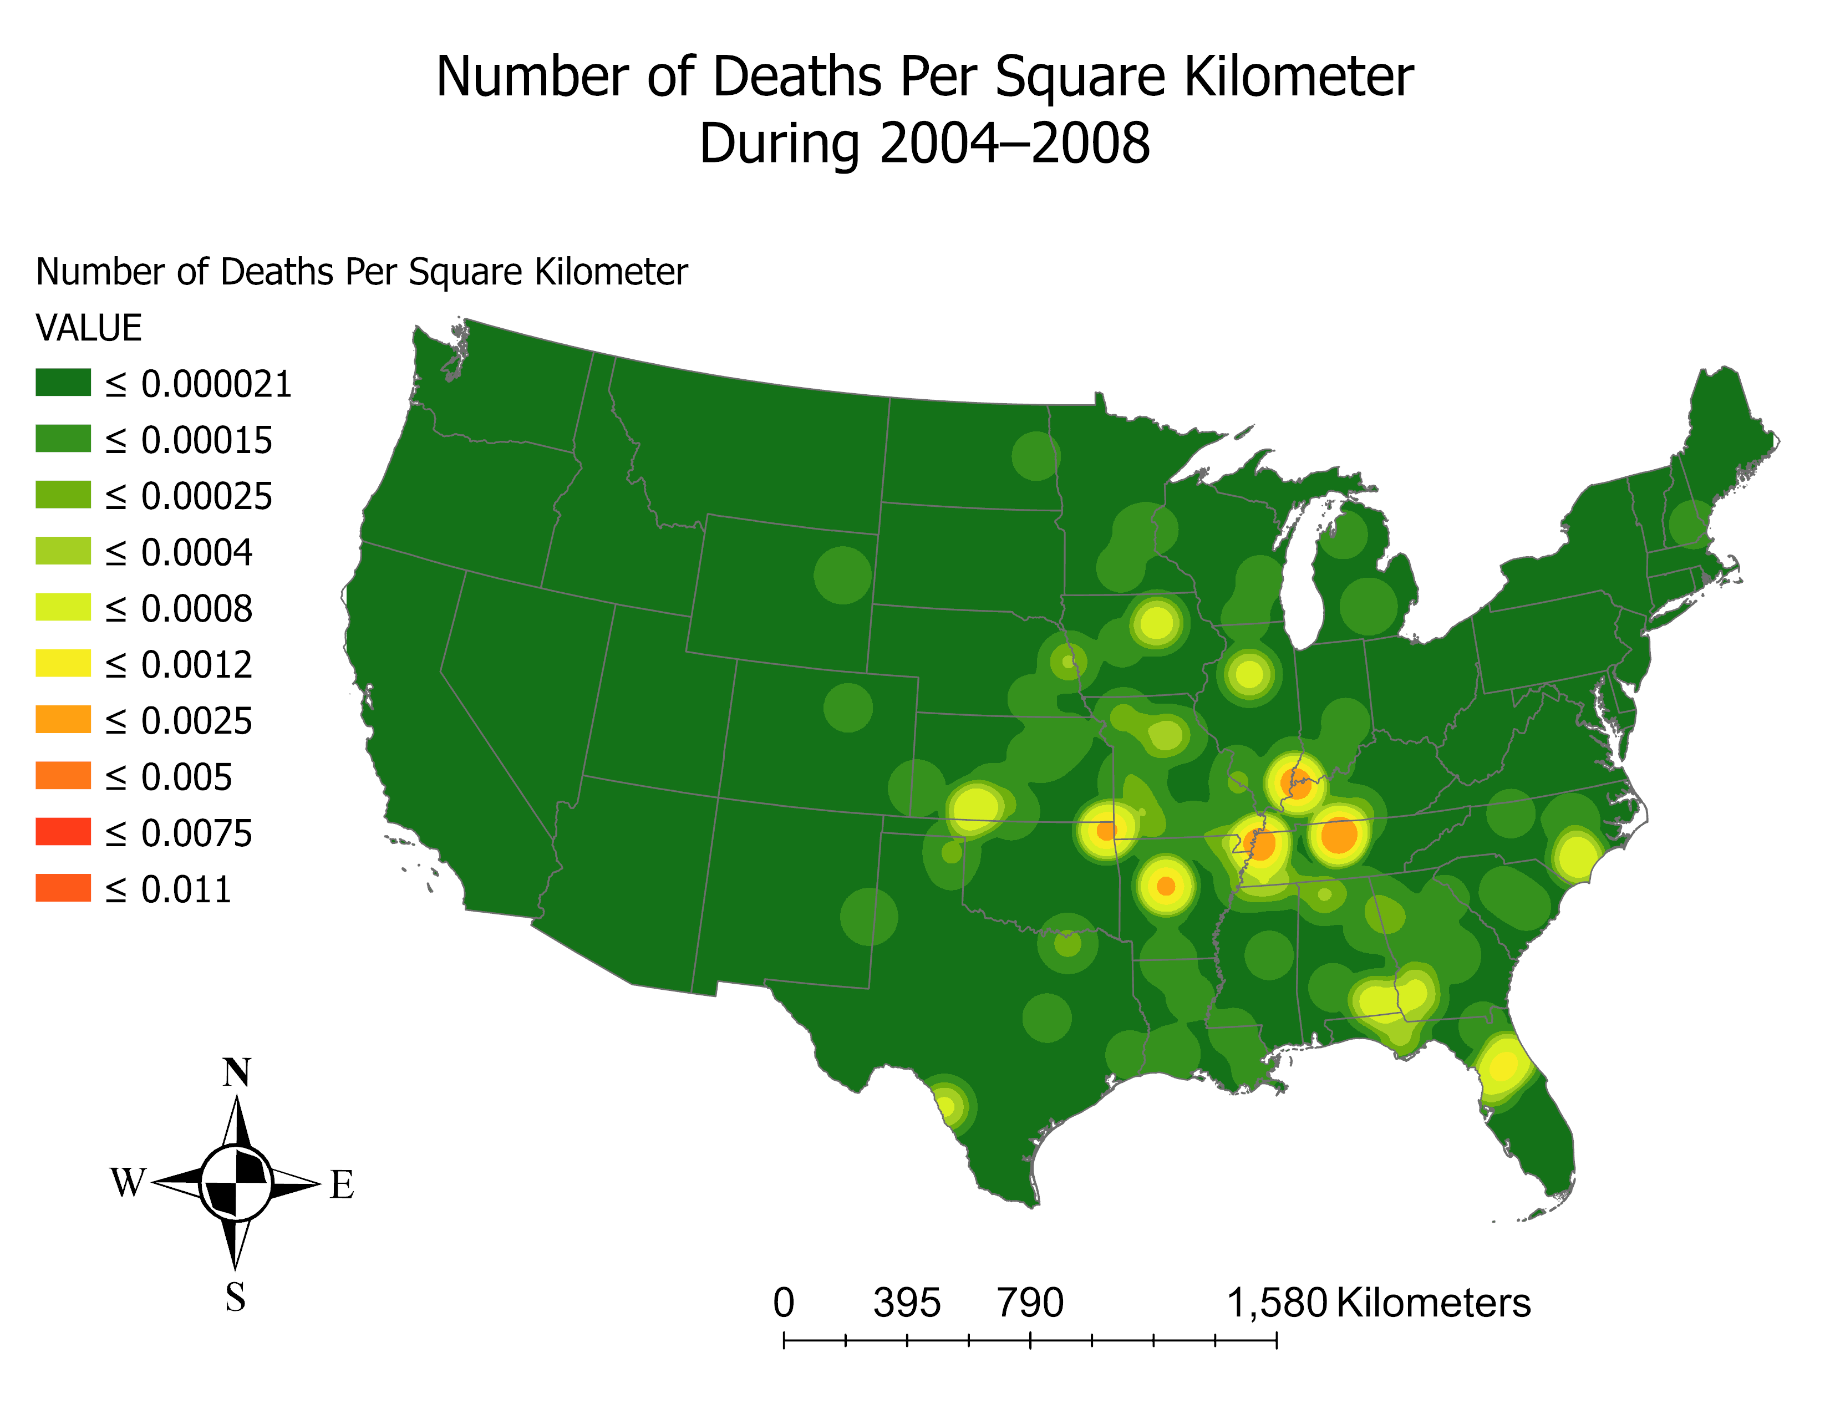

Slide 31


Slide 32


